Slide 1

WELCOME TO THE March 4, 2026 ​
ISOAG MEETING​
Information Security Officer's
Advisory Group
Notes:
Title slide - Any text that looks black is HEX code 414042. If you have an idea for an image, let me know and I can provide you with one.

Slide 2

Agenda Presenter
Welcome/Opening Remarks | Kendra Burgess / VITA
SMS/Voice deprecation for Okta | Luis Lugo / VITA
Legislative Updates/Potential Impacts | Michael Watson / VITA
MSS Update | Michael Watson / VITA
IR Planning | Scott Brinkley / VITA
Announcements and Upcoming Events | Kendra Burgess / VITA
Adjourn
vita.virginia.gov
Notes:
This slide background works best with text heavy sections, with no imagery OR when an Icon is used

Slide 3
Okta SMS (text) and voice disablement
Luis Lugo
Service Owner
March 2026

Slide 4
Agenda
Status and updates
Lessons learned
Next steps
Available resources

Slide 5
Status and updates
23 agencies have completed disablement for agency users
Now scheduling all agencies
Tentative schedules are shared by business relationship managers (BRM)
  Large agencies are expected to be scheduled over multiple days
End-user message has been refined and shared with BRMs

Slide 6
Lessons learned
Communications to end-users
  Remember their passcode
  COV password vs. Okta Verify passcode
  User can reset their own MFA if needed
If possible, users should be in office if they are registering for a new authenticator
  Avoid any potential confusion with virtual private network connection
When migrating, if a user has not already enrolled in another MFA options, they will be prompted to register an MFA option other than SMS and voice.

Slide 7
Next steps
Continue with Agency migrations
Remove the SMS/Voice option for new users
Targeting external agency applications
Cardinal Access
  If connected to the COV network, Cardinal can be accessed regularly. This applies to users in office or connected via VPN.
  When not on the COV network, a mobile authentication app must be used. Okta Verify or Google Authenticator are available options for Android or iOS.
  Recent Cardinal Update: DOA Cardinal team recently announced additional MFA that are expected to be available, they include Okta FastPass and YubiKeys. Be on the lookout for additional comms from DOA.

Slide 8
Available resources
VITA authentication services webpage
  Overview video
  Job aids
Recorded information session
Suggested end-user message as your agency is scheduled
Weekly reports provided your BRM
CAMs, BRMs and Agency Contacts
  (Includes Higher Education & Out of Scope Agencies and Localities)

Slide 9
Questions?

Slide 10
Legislative Updates / Potential Security Impacts
Michael Watson
CISO VITA/COV
March 4, 2026

Slide 11

Legislative Updates

Slide 12

General Dynamics IT MSS
Transition Update
Notes:
Title slide - Any text that looks black is HEX code 414042. If you have an idea for an image, let me know and I can provide you with one.

Slide 13
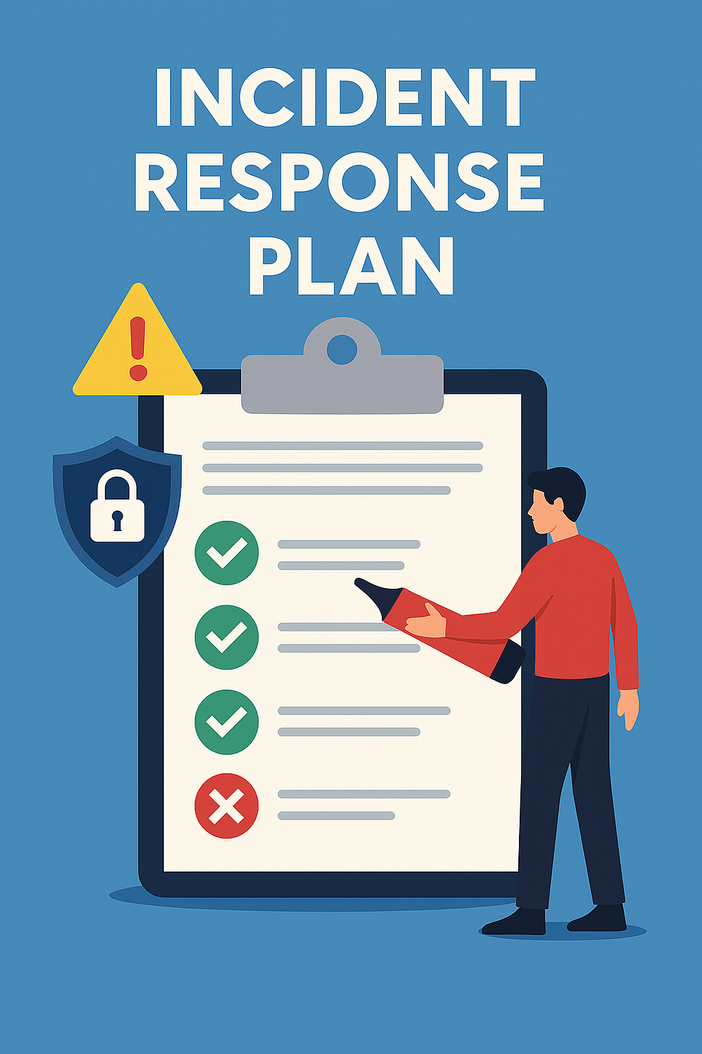
March 2026 ISOAG IR Planning
IR Plans – CSRM or Otherwise
Scott Brinkley – Incident Response Manager
March 4, 2026

Slide 14
Topics for Today
PART I
VITA CSRM IR Plan Access and Sharing
PART II
IR Planning – How Can We Help?
PART III
Quick Updates

Slide 15
Part I
VITA CSRM IR Plan Access and Sharing

Slide 16
Short Answer – No
Long Answer
Not sharing the IR Plan is, in all actuality, part of our obligations regarding the contracts we have engaged
The IR plan contains RACI charts and thusly contract information that is unfortunately not really for distribution
If the documentation were only processes and flow chart, then that may be shareable but then the documentation would be theoretical/educational and not functional

Slide 17
Part II
IR Planning – How Can We Help?

Slide 18

Incident Response Life Cycles
2 Main Theoretical Models

Slide 19
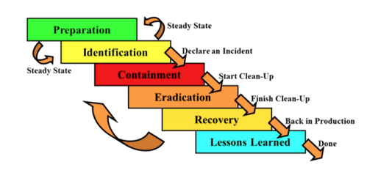
SANS PICERL Model
Moved Away
Too often Lessons Learned were thought of as an unnecessary step as it led to nothing but closure.

Slide 20
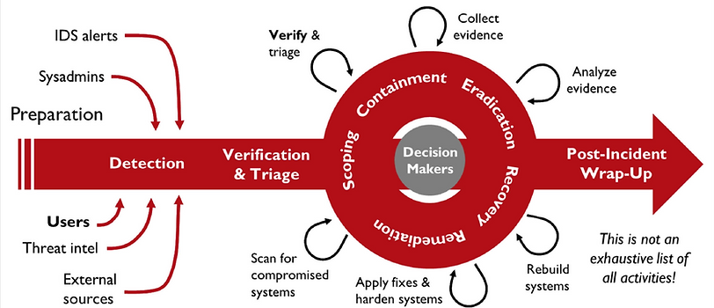
SANS DAIR – Dynamic Approach to Incident Response

Slide 21
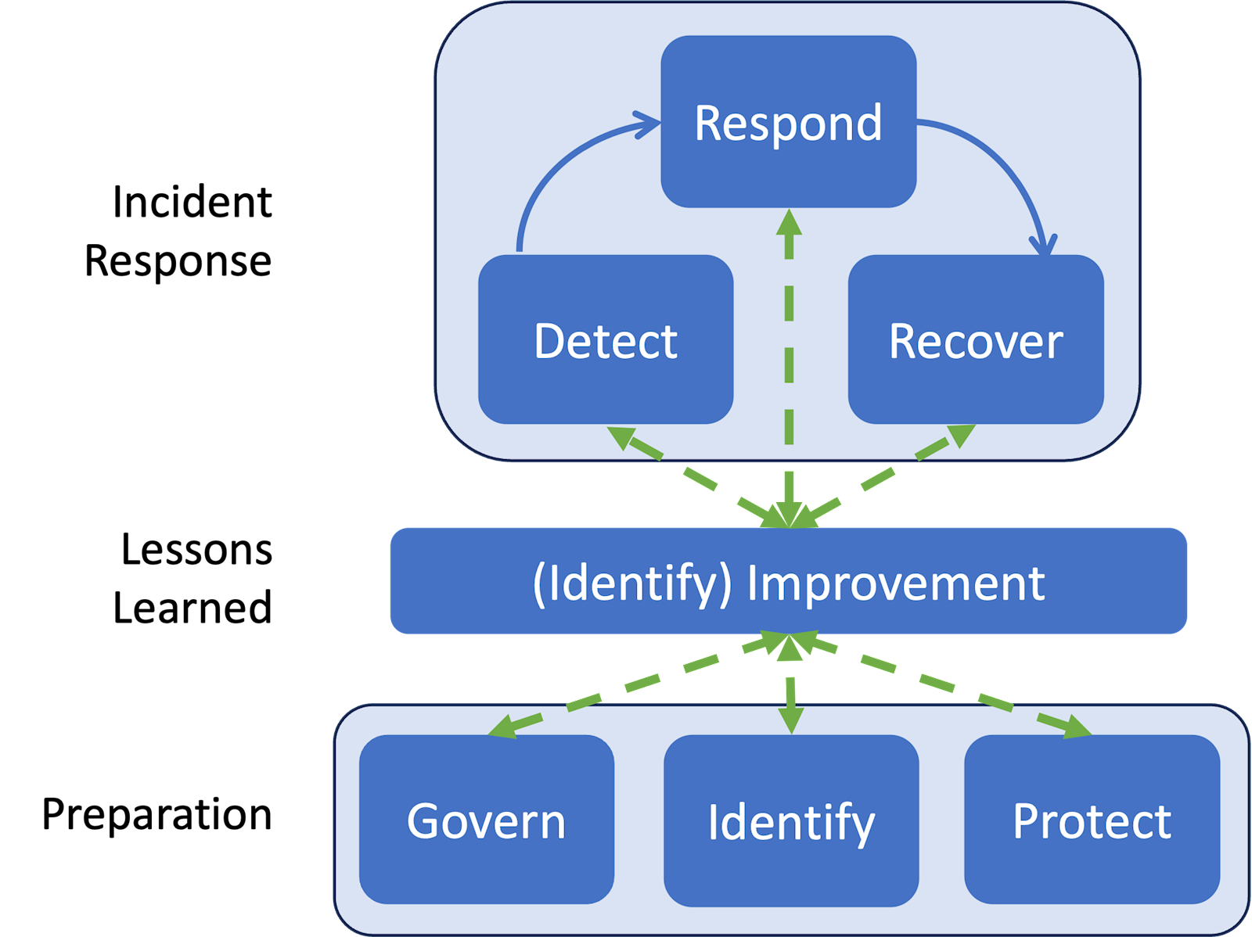
NIST Incident Response Life Cycle
New as of April 2025
Appears to have been adjusted for the same reason of addressing a lack of response improvement
Each box of this cycle makes sense individually, the whole leaves the observer looking for a starting place

Slide 22
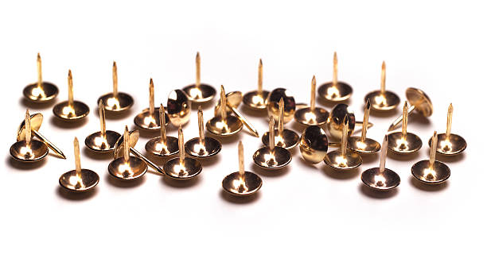
Now Forget All That
What does your IR plan need to actually be?
For most agencies without a security team this will most likely be mostly about reporting and containment
Template in the works based on previous assistance provided
IT Incident Response Policy Template

Slide 23
Part III
Quick Updates

Slide 24
New to Threat Management
Threat Intelligence and Advisories
You may receive threat intelligence advisories about specific vulnerabilities or campaigns that VITA is tracking within agency environments
Current priorities are vulnerabilities and exploit chains that lead to initial access, data disclosure, and remote code execution (particularly ransomware)
Requests for targeted research and reporting about a specific software exploit, threat actor, and other outputs from this program - Email jared.karnes@vita.virginia.gov
Updates coming to FIAR process
Those of you who have submitted have seen that I unfortunately get behind in responses
We are moving to a new ticket system internal to CSRM that will allow me to send automated confirmation emails upon submission and upon assigning to a Specialist
We are expanding very soon and there will be many hands to make light work

Slide 25

Questions
Scott Brinkley
Scott.Brinkley@vita.virginia.gov

Slide 26

Announcements
ISOAG March 2026
Notes:
Example of when to use this slide background for a call out section and text

Slide 27

Poll
Poll INCOMING! Steady at your Keyboards!
Please give us your feedback!

Slide 28

Threat Intelligence
• VITA is building out a cyber threat intelligence program. Let us know how the outputs from that program would be most helpful to your agency. Email jared.karnes@vita.virginia.gov
•You may receive threat intelligence advisories about specific vulnerabilities or campaigns that VITA is tracking within agency environments.
•The risks we currently prioritize are vulnerabilities and exploit chains that lead to initial access, data disclosure, and remote code execution (particularly ransomware).
•If you need targeted research and reporting about a specific software exploit, threat actor, etc. we may be able to help.
Notes:
Currently looking for the best place to house and share the advisories that will come out of the cyber threat intelligence program.

Slide 29


Top 5 Vulnerabilities
For the month of March, the Top 5 Key Vulnerabilities are:
WinVerifyTrust Signature Validation CVE-2013-3900 Mitigation (EnableCertPaddingCheck)
MS15-099: Vulnerabilities in Microsoft Office Could Allow Remote Code Execution (3089664)
Oracle Database Server (January 2026 CPU)
7-Zip < 25.00
Notepad++ < 8.8.9 Update Integrity Verification Vulnerability
*NOTE* Check CSRM Connections for more detailed information
vita.virginia.gov
Notes:
Speaking of website updates, the Top 5 is posted on the CSRM Connections site.
There have also been additional updates posted to the external website in the last month that aren’t listed on this slide. They are:
Risk Register Workbook
Risk Treatment Plan Template
Initial Corrective Action Plan Template
Quarterly Audit Remediation Plan Template
KB4 FAQ and Crosswalk
SEC514 update
Continuity of Operations Plan Template
Tenable User Guide on Connections under ISO Resources

Slide 30
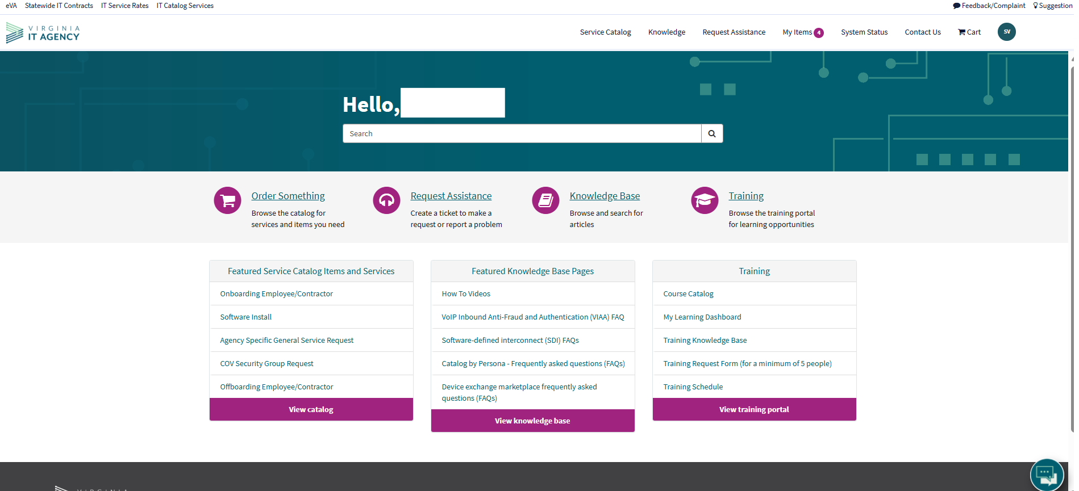
VCCC portal rebranding
The look and feel of the VITA service catalog will be modified to align with VITA branding guidelines. Development of the branding updates has been completed in our service catalog test environment. Implementation of updates will follow shortly.
When finalized, we will communicate the change date and send a newsletter that previews the changes.
vita.virginia.gov
Notes:
The rebranding should be completed by April 1st

Slide 31
Managing Disabled Accounts in COV AD and M365
When a Commonwealth of Virginia (COV) active directory (AD) account is disabled, it stops syncing to Microsoft 365 (M365), and the associated resources—such as the mailbox and OneDrive—entering a soft-deleted state.
Re-enable within 30 days: If the account is re-enabled during this period, it will resync and restore access to the original resources.
After 30 days: Resources are hard-deleted and cannot be recovered directly. While historical data remains searchable in Microsoft Purview (as all COV data is archived), the user will receive new resources (mailbox, OneDrive, etc.) upon re-enabling. To access historical data, the agency’s Purview administrator must run a search and export the data, which the user can then import into their new account.
Recommended steps to avoid data loss:
Ensure regular logins: Users—including contractors—should log into their COV account at least once per month to prevent automatic disabling due to inactivity.
Plan for extended inactivity: If a user will be inactive for an extended period, submit a request using the Temporary Disable COV Account catalog form. This option flags the account to continue syncing with M365 even while disabled.
VITA service catalog update: Feb. 19
vita.virginia.gov
Notes:
Quick reminder—when a COV AD account is disabled, M365 resources like mailbox and OneDrive are soft-deleted and must be restored within 30 days. After that, they’re permanently deleted, so please ensure users log in monthly or submit a temporary disable request to avoid data loss.

Slide 32

Virginia Cyber Security Partnership (VCSP)
Who We Are
The VCSP is a non‑profit collaboration between public and private sector cybersecurity professionals.
Established in 2012 to create a trusted community for discussing cyber threats and sharing best practices.
Our Mission
Strengthen cybersecurity across Virginia through:
Education – K‑12 outreach, collegiate engagement, member workshops
Collaboration – Networking, mentorship, small‑business cyber support
Partnership – Working with law enforcement and supporting cyber policy development
Get Involved
VCSP is seeking volunteers to support mission programs and community initiatives.
Interested? Contact: Amy Braden – Director, IT Security Governance & Compliance (VITA)
Notes:
VCSP held CyberConVA a few weeks ago. This is just a little more

Slide 33
Upcoming Events
vita.virginia.gov
Notes:
This slide is used as a transition title slide for a new section

Slide 34
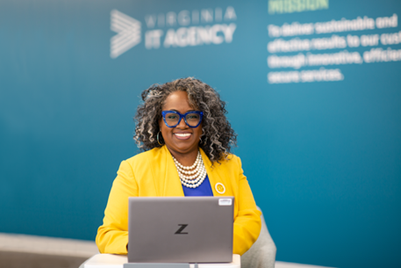
Upcoming Governance Office Hours
Governance Office Hours – a dedicated space for Agency ISOs and teams to bring their questions, concerns, or ideas.
March agenda: SEC527 Crosswalk Update & Commonly Missed Sections in Agencies Annual SAT - COOP & DR
Next Sessions:
March 10, 2026 | Microsoft Teams
[Click here to register for the meeting]
April 8: [Click here to register for the April meeting]
Let’s work together to strengthen governance across the Commonwealth!

Slide 35

IS Orientation
The next IS Orientation is being held on April 23, 2026
  April 23, from 9am to 4pm, registration closes April 7th.
  It will be held in-person at the Boulders location:
  7325 Beaufont Springs Drive, Richmond, VA 23225
  Visit Commonwealth IS Orientation to register!
Notes:
This slide works best with photos and graphs/charts. Image and text can be reversed

Slide 36

Service Tower SOC Report Review Sessions
      To register for this meeting, please click on the link below: https://covaconf.webex.com/weblink/register/r908b477733bd7adfbace299c8e431e4c
The upcoming SOC review session is March 11, 2026, and will be held remotely.
Please register at the link below
Notes:
Example of when to use this slide background for a call out section and text

Slide 37


Public Sector Network:
Government Innovation Showcase Virginia
When: April 23, 2026
Where: Richmond Marriott Downtown,
Richmond, VA
Government Innovation Showcase Virginia - Event | Public Sector Network

Slide 38
MEETING ADJOURNED
Notes:
Title slide - Any text that looks black is HEX code 414042. If you have an idea for an image, let me know and I can provide you with one.

Slide 39
IMAGE
Welcome to the March 4, 2026
ISOAG Meeting
Information Security Officer’s
Advisory Group
Notes:
No image title slide - Any text that looks black is HEX code 414042.

