Slide 1

Information Security Officer's
Advisory Group
WELCOME TO THE May 7, 2026 ​
ISOAG MEETING​
Notes:
Title slide - Any text that looks black is HEX code 414042. If you have an idea for an image, let me know and I can provide you with one.

Slide 2

Agenda Presenter
Welcome/Opening Remarks | Kendra Burgess / VITA
GDIT MSS | Steve Bishop / GDIT
Physical Security Breaches | Scott Brinkley / VITA
Okta Authentication Modernization: Saying Goodbye to SMS & Voice | Luis Lugo / VITA
Security Products and Services Updates | Uma Seshakrishnan and Matthew Umphlet / VITA
Upcoming Events | Kendra Burgess / VITA
Adjourn
vita.virginia.gov
Notes:
This slide background works best with text heavy sections, with no imagery OR when an Icon is used

Slide 3
MSS ISOAG
Virginia Information Technologies Agency (VITA)
VITA Managed Security Services (MSS)
May 7, 2026

Slide 4
CYBER
Secure today. Smarter tomorrow.
Cyber impacts every aspect of our lives. That is why GDIT is driven to ensure clients have cyber protection today, while outthinking the threats of tomorrow.
We Secure today, embedding resilient cyber solutions into every aspect of the mission. And we prepare for tomorrow, deploying new technology and partnerships to anticipate and preempt future risks.
We do all this because we know cyber is not a singular part of the mission – it’s the thread that runs across every endpoint, every network and every person. By proactively protecting, instantly responding and constantly evolving, GDIT makes today secure and tomorrow smarter.
Notes:
Instructions: What are the critical success factors for contract award preparation. This often includes things like:
Identifying high-value incumbent staff
Aggressive recruitment
Swapping-out/locking-down key and/or critical personnel
Making quick-turn deliverables assignments
Addressing a specific, high-risk proposal assumption

Slide 5
Secure today smarter tomorrow
Notes:
Instructions: What are the critical success factors for contract award preparation. This often includes things like:
Identifying high-value incumbent staff
Aggressive recruitment
Swapping-out/locking-down key and/or critical personnel
Making quick-turn deliverables assignments
Addressing a specific, high-risk proposal assumption

Slide 6
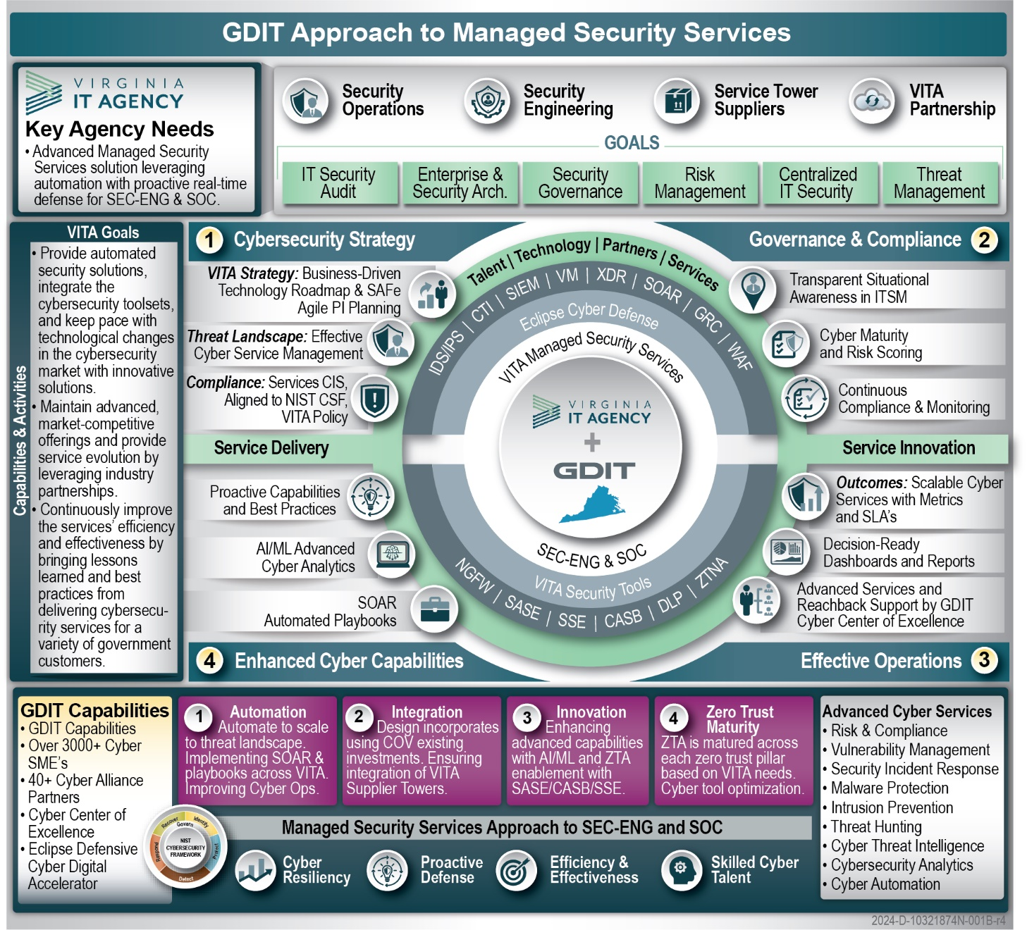
GDIT Managed Security Services
GDIT’s Key Goals to Support VITA’s Managed Security Services
Automation – Bring automation throughout VITA security tooling and operations - leverage Splunk SOAR capabilities to scale threat protection across VITA’s Enterprise
Integration – Leverage VITA’s existing investments across the COV as much as possible focused on integration and advancement - eliminate proprietary systems and share security data to ensure the maximum integration and effective use of cybersecurity-related data
Innovation – Bring innovative cybersecurity capabilities leveraging AI/ML, advanced threat intelligence, cloud-native security tools, and advanced Zero Trust maturity
Zero Trust Maturity – Implement mature Zero Trust integrations, playbooks, and architectures to advance VITA’s Zero Trust maturity strategy
Notes:
Instructions: What are the critical success factors for contract award preparation. This often includes things like:
Identifying high-value incumbent staff
Aggressive recruitment
Swapping-out/locking-down key and/or critical personnel
Making quick-turn deliverables assignments
Addressing a specific, high-risk proposal assumption

Slide 7
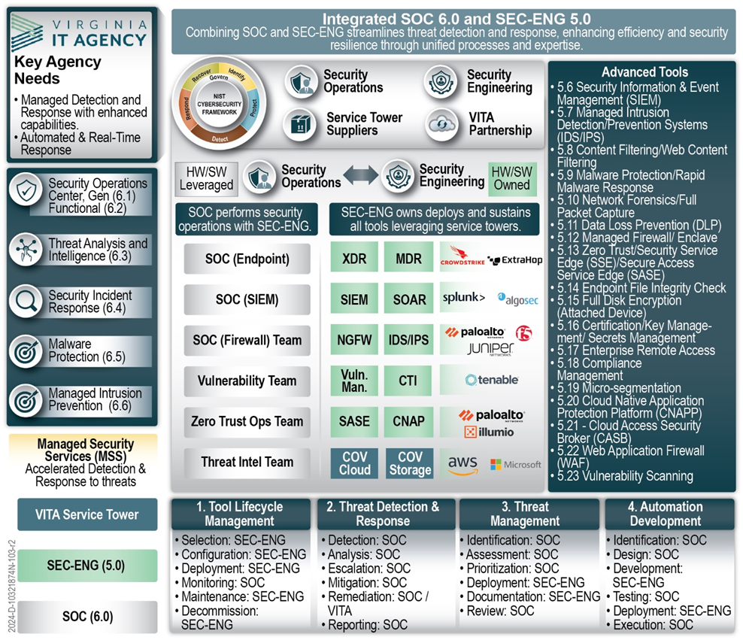
Benefits to GDIT’s Integrated Managed Security Services
Automate and Innovate enhancements while adapting to VITA’s ever changing and evolving Managed Environment
Leverage the tools as part of Security Engineering capability
  CrowdStrike
  Tenable One
  Splunk
  Palo Alto Next Generation Firewalls
Align with VITA’s current strategic investments and allow for a more seamless transition to VITA’s desired future security state
Collaborate with VITA and COV Agencies to support the deployment, configuration, and management of Security Services for the Commonwealth
Integrate of tools and technologies into GDIT’s operations-based framework to support seamless implementation of tools into the effective delivery of SOC services
Notes:
Instructions: What are the critical success factors for contract award preparation. This often includes things like:
Identifying high-value incumbent staff
Aggressive recruitment
Swapping-out/locking-down key and/or critical personnel
Making quick-turn deliverables assignments
Addressing a specific, high-risk proposal assumption

Slide 8
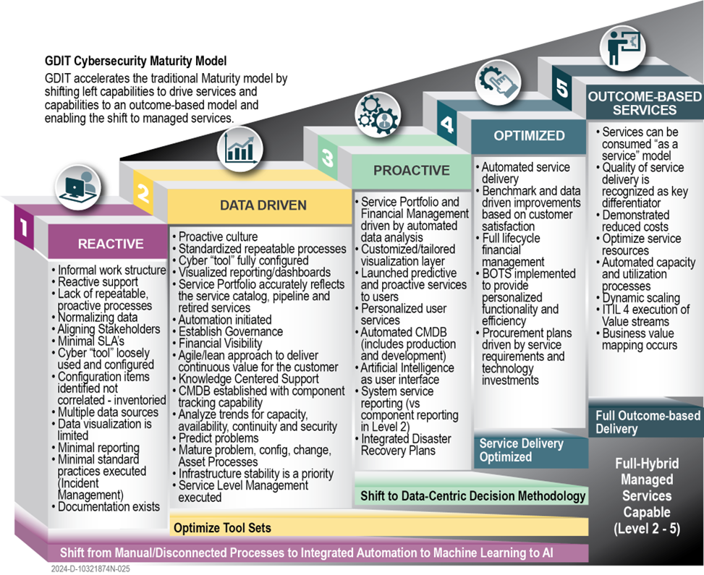
GDIT Cybersecurity Model
GDIT’s Steps to Support VITA’s Security Maturity Strategy
Level 1: Reactive - Identify opportunities to mature processes, provide data visualization and reporting, integrate cybersecurity technology capabilities, and baseline configurations for each of our services
Level 2: Data-Driven - Visibility and transparency drive decision-ready data for VITA and provides a foundation for analysis of service performance and comparison to the baselines
Level 3: Proactive - Transitions the cybersecurity services into a mode of tailored visualization, automation, and leveraged AI - shift to data-centric decision methodologies to help inform VITA
Level 4: Optimized - Data-driven improvement and integrated strategic procurement and financial planning - identify customer-centered capabilities to drive efficiencies and automated service delivery
Level 5:, Outcome-Based Services - Build upon the optimized services into an “As a service” model - focus on quality, cost reduction, dynamic scaling, and business value mapping for optimized outcomes
Notes:
Instructions: What are the critical success factors for contract award preparation. This often includes things like:
Identifying high-value incumbent staff
Aggressive recruitment
Swapping-out/locking-down key and/or critical personnel
Making quick-turn deliverables assignments
Addressing a specific, high-risk proposal assumption

Slide 9
GDIT/ Art of the possible

Slide 10

May 2026 ISOAG
Physical Security Breaches
Scott Brinkley – Incident Response Manager
May 7, 2026

Slide 11
Outlined Responsibility
SEC530-01.2
Section 8.11 – Physical and Environmental Protection

Slide 12
Physical Breach
What does the Agency Information Security Team need to do?

Slide 13
Determine Type of Breach
Importance of Physical Breach Type
Possibilities vary based on type
Levels of access can be attained based on physical breach type
Types of Physical Breaches
Person to Person (deceptive)
Access to COV Device
Access to COV Network
Unmanned Vehicle Access (Drone, etc.)

Slide 14

Person-to-Person
Concerns presented
Tailgating into the building
Theft of badge or capture of badge RFID
Theft of state device (mobile device or workstation). Includes getting victim to log in for some urgent reason.
Slyly working historical data about the victim into conversation (first pet, primary school names and locations) for security questions or password guesses
  (Did I go to High school with you? What was our mascot again?). Sounds silly but enough charisma and it works.

Slide 15

Access to COV Device
Access Controls
Device lost or stolen? Is access granted while lost? (Post it note with password, etc.)
Was mobile device or workstation logged in when stolen granting access innately?
Was device left unattended in public space?
Was a small unknown peripheral connected to device?
Was access granted inordinately to a server?
  *Analyze device that was accessed*

Slide 16
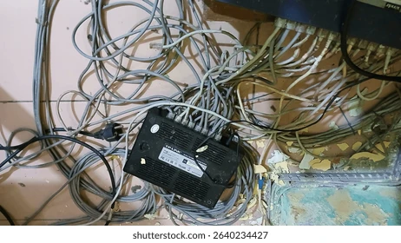
Access to COV Networks
Method of Access
Cutting network access to all or parts of a physical space
Physical implantation of device (Raspberry Pi)
Physical access to edge device to open it to a specific outsider
Physical access to configuration server to open it to outside influence
Physical access to wireless with known password list in attempt to brute force network.
**Bluetooth to a Mobile Device is still a COV network.
  Air-dropping illicit images onto state mobile devices

Slide 17

Unmanned Vehicle Access
What am I talking about?
Drones, RC Cars, something else that I haven’t thought of for the purposes of this exercise that can make its way into or around a building to provide some kind of access
Potential Implications
  Brute-forcing wireless with automation
  Dropping some kind of transmission blocker
  Dropping illicit materials
  Testing security response times
  Least likely - Attempting to plug in something to either the network or a COV device unnoticed

Slide 18
Keys for ISOs
REPORT, REPORT, REPORT…
https://www.reportcyber.virginia.gov/cyber-incident-form/executive-branch-agency/
VCCC
Notify VSP as it is a State Executive Branch breach
Still unsure?
incident.response@vita.virginia.gov
Document, Document, Document…
Get camera footage
Badge access logs
Time physical incident discovered
Last known good time
Photograph individual or device if discovered on premises
Heavily document area surrounding any found devices

Slide 19

Questions
Scott Brinkley
Scott.Brinkley@vita.virginia.gov

Slide 20
Okta Authentication Modernization: Saying Goodbye to SMS & Voice
Luis Lugo
Service Owner
Nick Kuriger
Security Operations
May 7, 2026

Slide 21
Agenda
Project recap
Ongoing support
Accomplishments

Slide 22
Background, review & challenges
Okta announcement to deprecate SMS and Voice; COV planned migration off SMS and Voice while maintaining security
  Vulnerable to interception, phishing, and hijacking
Challenges
  High impact
    End-user action required– over 130,000 accounts
    1000+ application integrations
  Variance of agency use cases
  Consideration of financial implications
Project stakeholders
  Agencies
  Help desk and account administration
  Business relationship managers
  Cardinal

Slide 23
Agile planning & implementation
Email communications & monthly updates
Coordination with various stakeholders: weekly reports & meetings
VITA webpage: central information source
  Job aids and videos for internal and external users
Minimizing agency costs
  Utilized software that was available for use
    Okta Verify for mobile
    Google Authenticator
  Deployed additional options and tools
    Okta Verify/Okta Fastpass for Desktop
    FIDO2 w/Yubikeys
    Okta TAC
Timeline: Coordinated deadline extensions with Okta

Slide 24
Ongoing support
New users & users who have not migrated - Job aids and tips that were shared for the migration off SMS and voice continue to be relevant
  Remember your Okta Passcode
  Don’t confuse it with your COV password
  Use the self-service options
Emerging agency use cases that VITA will need to support and address
Optimize and enhance capabilities of tools and processes
  Improve end-user experience

Slide 25
Accomplishments & lessons learned
Agency costs – minimized by creating low-cost options (absorbed by enterprise)
Large end-user migration support
  Gathering unique agency requirements
  Authentication services webpage
    Videos & job aids
  Help desk support and scripts
  Service portal announcements
Security - Alignment with zero trust
  We released modern technology and authenticators
Standardization enables broad adoption of useful and emerging technology

Slide 26
Thank you!

Slide 27
Security Products and Services Updates
Uma Seshakrishnan
Security Products Manager
Matthew Umphlet
Security Solutions Manager
May 7, 2026

Slide 28
Vendor Workshops
Splunk Workshop Recap (April 30)
Thank you for attending the Splunk workshop last Thursday
Please complete the survey: We will be emailing you the survey link along with the CPE credits.
Helps us understand how we did
Share which product and level you’d like to see in the workshop next
Upcoming Workshop – Save the Date
July 21
⏰ Same time | 📍 Same location
🔔 Registration details will be shared closer to the date

Slide 29
SPAS Office hours
Security Products and Services Office Hours – Schedule for May
📅 May 13
⏰ 2:00 – 3:00 PM
🔗 Join Link: VITA Connections/Events
Sample Agenda
Welcome & Housekeeping
Introductions, recording notice, agenda overview
Program Updates
Latest announcements & milestones
Update from Threat Management Team (1st Session)
Action Item Review
Recap prior items, owners, and status
Open Q&A / Issue Review
Live questions and issue discussion
Follow-ups scheduled as needed
Wrap-Up & Next Steps
Key takeaways and next session preview
📅 May 27
⏰ 2:00 – 3:00 PM
🔗 Join Link: VITA Connections/Events
vita.virginia.gov
Notes:
Speaking of website updates, the Top 5 is posted on the CSRM Connections site.
There have also been additional updates posted to the external website in the last month that aren’t listed on this slide. They are:
Risk Register Workbook
Risk Treatment Plan Template
Initial Corrective Action Plan Template
Quarterly Audit Remediation Plan Template
KB4 FAQ and Crosswalk
SEC514 update
Continuity of Operations Plan Template
Tenable User Guide on Connections under ISO Resources

Slide 30
Splunk Dashboard Walkthrough

Slide 31
Splunk as the Enterprise SIEM
Splunk integrates threat intelligence for VITA infrastructure services and agency threat feeds. This allows correlation of multiple data sources for visibility and management of the entire threat landscape
Agency information security officers have access to Splunk and should manage access requests for their agency.
Logs available in the Splunk Agency Dashboards
  Office 365
  Windows Authentication Logs
  Okta
  Box
  Area 1 Security
  Isilon
  CrowdStrike
  CrowdStrike Devices
  IIS
  Apache
  DLP

Slide 32
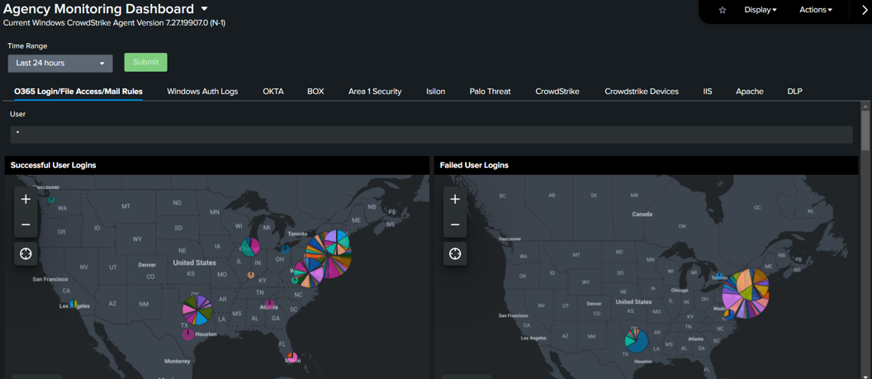
Splunk Agency Dashboard Walkthrough
https://cov.splunkcloudgc.com/en-US/app/Agency_Dashboards/
vita.virginia.gov
Notes:
Speaking of website updates, the Top 5 is posted on the CSRM Connections site.
There have also been additional updates posted to the external website in the last month that aren’t listed on this slide. They are:
Risk Register Workbook
Risk Treatment Plan Template
Initial Corrective Action Plan Template
Quarterly Audit Remediation Plan Template
KB4 FAQ and Crosswalk
SEC514 update
Continuity of Operations Plan Template
Tenable User Guide on Connections under ISO Resources

Slide 33
Additional FAQs
How can a user be added to Splunk?
  Agency ISOs should submit a general service request (GSR) to add additional users to Splunk. The GSR should include the name and email of the agency user(s), as well as the agency’s Splunk AD group name.
  AD groups for Splunk use the following naming pattern: A<agency number>-AC-<agency acronym>-SPLUNK-ANALYST-OKTA

Slide 34
Training and Additional Resources
Splunk provides free eLearning!
https://www.splunk.com/en_us/training/basic-subscription.html
Additional in KB0019482 on the VCCC
Commonwealth security and risk management (CSRM) suggests that all ISOs and other individuals utilizing Splunk create an account and watch the following eLearning videos:
  What is Splunk?
  Intro to Splunk

Slide 35
Questions
Uma Seshakrishnan
Matthew Umphlet
Uma.Seshakrishnan@vita.virginia.gov
Matthew.Umphlet@vita.virginia.gov

Slide 36

Announcements
ISOAG May 2026
Notes:
Example of when to use this slide background for a call out section and text

Slide 37

Pluralsight
Primary ISOs will be able to access the ccccc Pluralsight training platform!
More information to come in the June ISOAG!
vita.virginia.gov
Notes:
Speaking of website updates, the Top 5 is posted on the CSRM Connections site.
There have also been additional updates posted to the external website in the last month that aren’t listed on this slide. They are:
Risk Register Workbook
Risk Treatment Plan Template
Initial Corrective Action Plan Template
Quarterly Audit Remediation Plan Template
KB4 FAQ and Crosswalk
SEC514 update
Continuity of Operations Plan Template
Tenable User Guide on Connections under ISO Resources

Slide 38

Threat Intelligence
• VITA is building out a cyber threat intelligence program. Let us know how the outputs from that program would be most helpful to your agency. Email jared.karnes@vita.virginia.gov
•You may receive threat intelligence advisories about specific vulnerabilities or campaigns that VITA is tracking within agency environments.
•The risks we currently prioritize are vulnerabilities and exploit chains that lead to initial access, data disclosure, and remote code execution (particularly ransomware).
•If you need targeted research and reporting about a specific software exploit, threat actor, etc. we may be able to help.
Notes:
Currently looking for the best place to house and share the advisories that will come out of the cyber threat intelligence program.

Slide 39


Top 5 Vulnerabilities
For the month of May, the Top 5 Key Vulnerabilities are:
KB5077181: Windows 11 Version 24H2 / Windows 11 Version 25H2 Security Update (February 2026)
Security Update for Microsoft Visual Studio Code (February 2026)
Microsoft .NET Core SEoL
ASP.NET Core SEoL
Oracle Java SE Multiple Vulnerabilities (April 2026 CPU)
*NOTE* Check CSRM Connections for more detailed information
vita.virginia.gov
Notes:
Speaking of website updates, the Top 5 is posted on the CSRM Connections site.
There have also been additional updates posted to the external website in the last month that aren’t listed on this slide. They are:
Risk Register Workbook
Risk Treatment Plan Template
Initial Corrective Action Plan Template
Quarterly Audit Remediation Plan Template
KB4 FAQ and Crosswalk
SEC514 update
Continuity of Operations Plan Template
Tenable User Guide on Connections under ISO Resources

Slide 40
Managing Disabled Accounts in COV AD and M365
Use it or Lose it! (Or you can place it on hold…)
If a COV account is disabled due to inactivity – re-enable the account within 30 days to resync and restore access to user data (mailbox, OneDrive, etc.)
After 30 days: Resources are hard-deleted and cannot be recovered directly.
Recommended steps to avoid data loss:
Ensure regular logins: Users—including contractors—should log into their COV account at least once per month to prevent automatic disabling due to inactivity.
Plan for extended inactivity: If a user will be inactive for an extended period, submit a request using the Temporary Disable COV Account catalog form. This option flags the account to continue syncing with M365 even while disabled.
VITA service catalog update: Feb. 19
vita.virginia.gov
Notes:
Quick reminder—when a COV AD account is disabled, M365 resources like mailbox and OneDrive are soft-deleted and must be restored within 30 days. After that, they’re permanently deleted, so please ensure users log in monthly or submit a temporary disable request to avoid data loss.

Slide 41

Virginia Cyber Security Partnership (VCSP)
Who We Are
The VCSP is a non‑profit collaboration between public and private sector cybersecurity professionals.
Established in 2012 to create a trusted community for discussing cyber threats and sharing best practices.
Our Mission
Strengthen cybersecurity across Virginia through:
Education – K‑12 outreach, collegiate engagement, member workshops
Collaboration – Networking, mentorship, small‑business cyber support
Partnership – Working with law enforcement and supporting cyber policy development
Get Involved
VCSP is seeking volunteers to support mission programs and community initiatives.
Interested? Contact: Amy Braden – Director, IT Security Governance & Compliance (VITA)
Notes:
VCSP held CyberConVA a few weeks ago. This is just a little more

Slide 42

Survey
Attention s'il vous plait
Achtung, bitte
Let op, alstublieft
Athygli vinsamlegast
Oppmerksomhet, vær så snill
Xin chú ý
Atención, por favor
Aire, le do thoil
Or in plain English, give this some attention, please! ☺

Slide 43
Upcoming Events
vita.virginia.gov
Notes:
This slide is used as a transition title slide for a new section

Slide 44
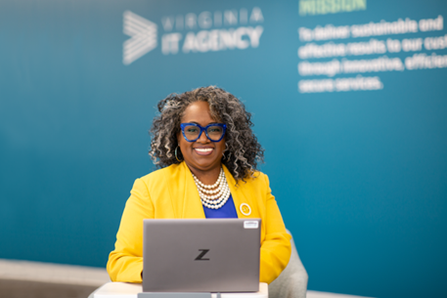
Upcoming Governance Office Hours
Governance Office Hours – a dedicated space for Agency ISOs and teams to bring their questions, concerns, or ideas.
May agenda: Enrollment user-listing
Groups and Finding Updates form
Next Sessions:
May 13, 2026 | Microsoft Teams
[Click here to register for the meeting]
June 17: [Click here to register for the meeting]
Let’s work together to strengthen governance across the Commonwealth!

Slide 45

IS Orientation
The next IS Orientation is being held on May 14, 2026
  May 14, from 9am to 4pm, registration closes April 28th.
  It will be held in-person at the Boulders location:
  7325 Beaufont Springs Drive, Richmond, VA 23225
  Visit Commonwealth IS Orientation to register!
Notes:
This slide works best with photos and graphs/charts. Image and text can be reversed

Slide 46

Service Tower SOC Report Review Sessions
      To register for this meeting, please click on the link below: https://covaconf.webex.com/weblink/register/rfbee0a945b71936d5d0142c932840b86
The upcoming SOC review session is June 11, 2026, and will be held remotely.
Please register at the link below
Notes:
Example of when to use this slide background for a call out section and text

Slide 47

Security Services Fair
June 17, 2026 from 9 am – 11 am
We will be pleased to welcome ISOs and those interested in Security to the Security Services Fair here at the Boulders.
7325 Beaufont Springs Drive, Richmond, VA 23225
Training Room
Registration is required
vita.virginia.gov

Slide 48

COV Information Security Conference
Please join us on Thursday, August 13, 2026
at The Westin: 6631 West Broad Street, Richmond, VA
Register today!
vita.virginia.gov

Slide 49
Information Security Conference 2026
Commonwealth of Virginia
The Quantum Mirror: Reflecting on Security in a Multiverse
Aug. 13
The Westin Richmond
Henrico, VA
Learn more at: vita.virginia.gov/isc

Slide 50
MEETING ADJOURNED
Notes:
Title slide - Any text that looks black is HEX code 414042. If you have an idea for an image, let me know and I can provide you with one.

Slide 51
Information Security Officer’s
Advisory Group
Welcome to the May 6, 2026
ISOAG Meeting
Notes:
No image title slide - Any text that looks black is HEX code 414042.

