Slide 1
Welcome to the January 7, 2026
ISOAG Meeting
IMAGE
Information Security Officer’s
Advisory Group
Notes:
No image title slide - Any text that looks black is HEX code 414042.

Slide 2


Agenda Presenter
Welcome/Opening Remarks | Kendra Burgess/ VITA
Partnering for Cyber Resilience: A Strategic Update on VITA's Security Awareness Program | Breon Worthy and Lucas Broad / KnowB4
Tabletop exercise | Zachary Wilton / SAIC
Server OS and SQL Upgrades for 2026 | John Del Grosso/ VITA
Okta SMS (text) and voice disablement | Luis Lugo / VITA
NCSR Self-Assessment Recording | Andrew Wirz / VITA
Announcements and Upcoming Events | Kendra Burgess/ VITA
Adjourn
vita.virginia.gov
Notes:
This slide background works best with text heavy sections, with no imagery OR when an Icon is used

Slide 3



Virginia Information Technologies Agency
Jan 2026 ISOAG Meeting
Enterprise Customer Success Manager

Slide 4
Agenda

Slide 5










Introductions
Meet your KnowBe4 advisors
Agenda
KnowBe4 empowers your workforce to make smarter security decisions every day. During this meeting our plan is to align our shared goals, and discuss the long term vision of Human Risk Management within your organization.
KnowBe4 Partnership Overview
Mission Overview
Subscription Offering
Strategic Outlook For Leadership
Future opportunities and upcoming priorities
Expansion
Additional products
Resources
Roadmap and recommendations

Slide 6
Introductions

Slide 7



Meet Your KnowBe4 Team
Breon Worthy
Customer Success Manager
Lucas Brand
Account Manager
© 20265 KnowBe4, Inc. All rights reserved.

Slide 8
KnowBe4 Partnership Overview
© 20265 KnowBe4, Inc. All rights reserved.

Slide 9


We are in this together
Enterprise Customer Success Manager
Since 2022
Vision
I serve as your strategic partner and VITA’s primary point of contact for maximizing the value of your KnowBe4 security awareness investment. My role goes beyond traditional vendor support—I'm here to ensure your state and local government agencies achieve measurable risk reduction and build lasting security cultures.
Government Sector Expertise: Deep understanding of the unique challenges facing state and local agencies
Strategic Planning: Collaborative program development aligned with your compliance requirements and threat landscape
Data-Driven Insights: Regular analysis of your program metrics to identify opportunities and address gaps
Proactive Support: Quarterly business reviews, best practice sharing, and early access to new capabilities
Executive Advocacy: Resources and insights to help you demonstrate program value to leadership
© 20265 KnowBe4, Inc. All rights reserved. 7

Slide 10
What your subscription offers
Security Awareness Training Reimagined

Slide 11

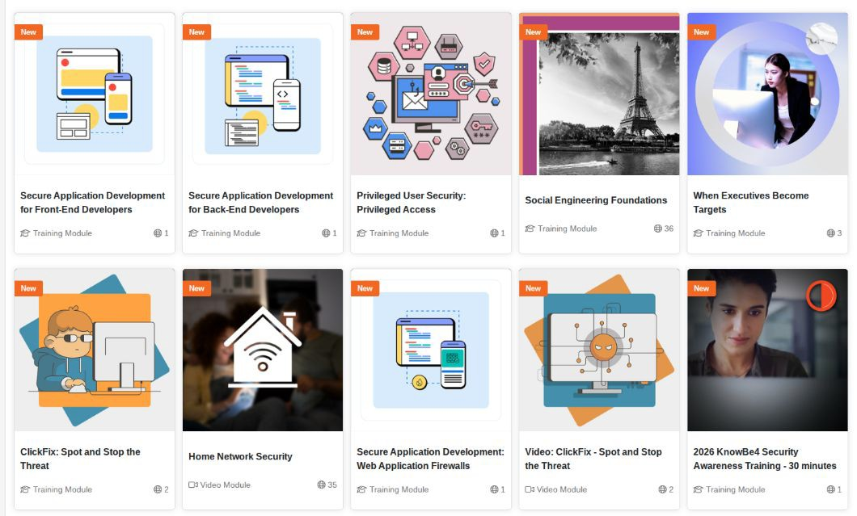
Diamond Level
With over 1736+ pieces of content the Diamond level offers the most robust offerings of security awareness, human risk management content in the world!
Content types
Training Modules
Video Modules
Newsletters
Games
Audiocast
Posters
Organizations Assessments

Slide 12
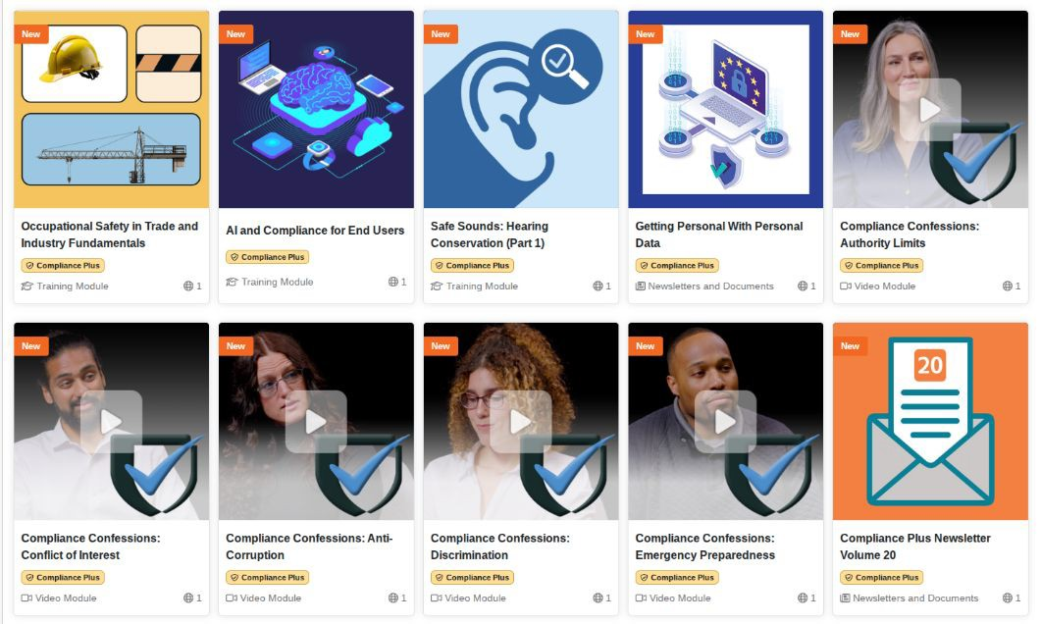
Compliance Plus
942 of the top compliance related content.
Content Topics
Data Privacy
Labor Laws
Harassment
Physical Security
Developer Training
Anti Bribery

Slide 13

Newsletters
Newsletters can help keep your users informed about security threats and help reinforce the topics they learn about in their security training.
Every month, KnowBe4 updates our Security Hints and Tips newsletter category with new information about common cybersecurity topics, such as the importance of using a VPN and protecting passwords.
The Scam of the Week is a weekly newsletter written by KnowBe4. The newsletter summarizes a recent
real-world scam and provides tips on how to stay safe from similar scams.
© 2026 KnowBe4, Inc. All rights reserved.

Slide 14
Targeted Training
How do I select training topics?
KnowBe4 has the most extensive security awareness library to help you manage the ongoing problem of
social engineering.
We recommend that you use our Automated Security Awareness Program (ASAP), a revolutionary tool for creating and implementing a fully mature, customized program for your organization.
Identify Roles within your organization that have elevated access or are more sensitive in nature
Review compliance requirements by state, county, industry
Custom Learning Paths
Industry Speciﬁc Content
Role Based

Slide 15




Training in your Environment
Requirements
What type of training requirements do you follow within your organization?
Frequency
How often do you provide cybersecurity awareness training to your organization, including executives?
Participation
Is your training required or optional? How does that impact your completion rate?
Style
What formats of delivery have you assigned so far and what resonates best with your employees?

Slide 16
Strategic Outlook For Leadership

Slide 17
Security Awareness Proﬁciency Assessment
Gain insight into your organization’s strengths and weaknesses in security awareness knowledge
Your assessment results will provide you with:
General knowledge areas where your organization could improve
Recommended training content
Compare results over time
Improve Speciﬁc Knowledge Areas
You can use this information to create targeted phishing and training campaigns that ﬁt your users' needs.
Assess Seven Areas
Data Driven

Slide 18


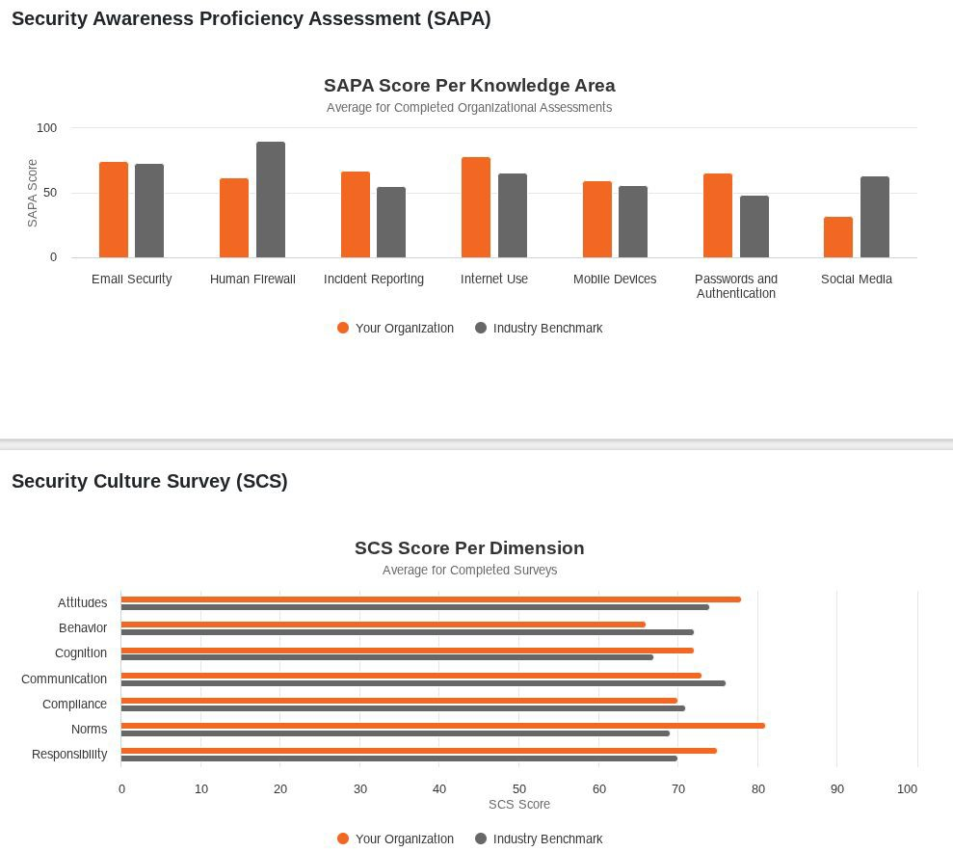

Assessment and Benchmarking
Organizational assessments help you evaluate your organization’s current security awareness knowledge and security culture.
Organizational assessments are not used for training purposes. Instead, they are used to help you gain insight into the strengths and weaknesses of your organization.
Organization & Industry
Stats can be found on your account dashboard.
© 20265 KnowBe4, Inc. All rights reserved.
16

Slide 19
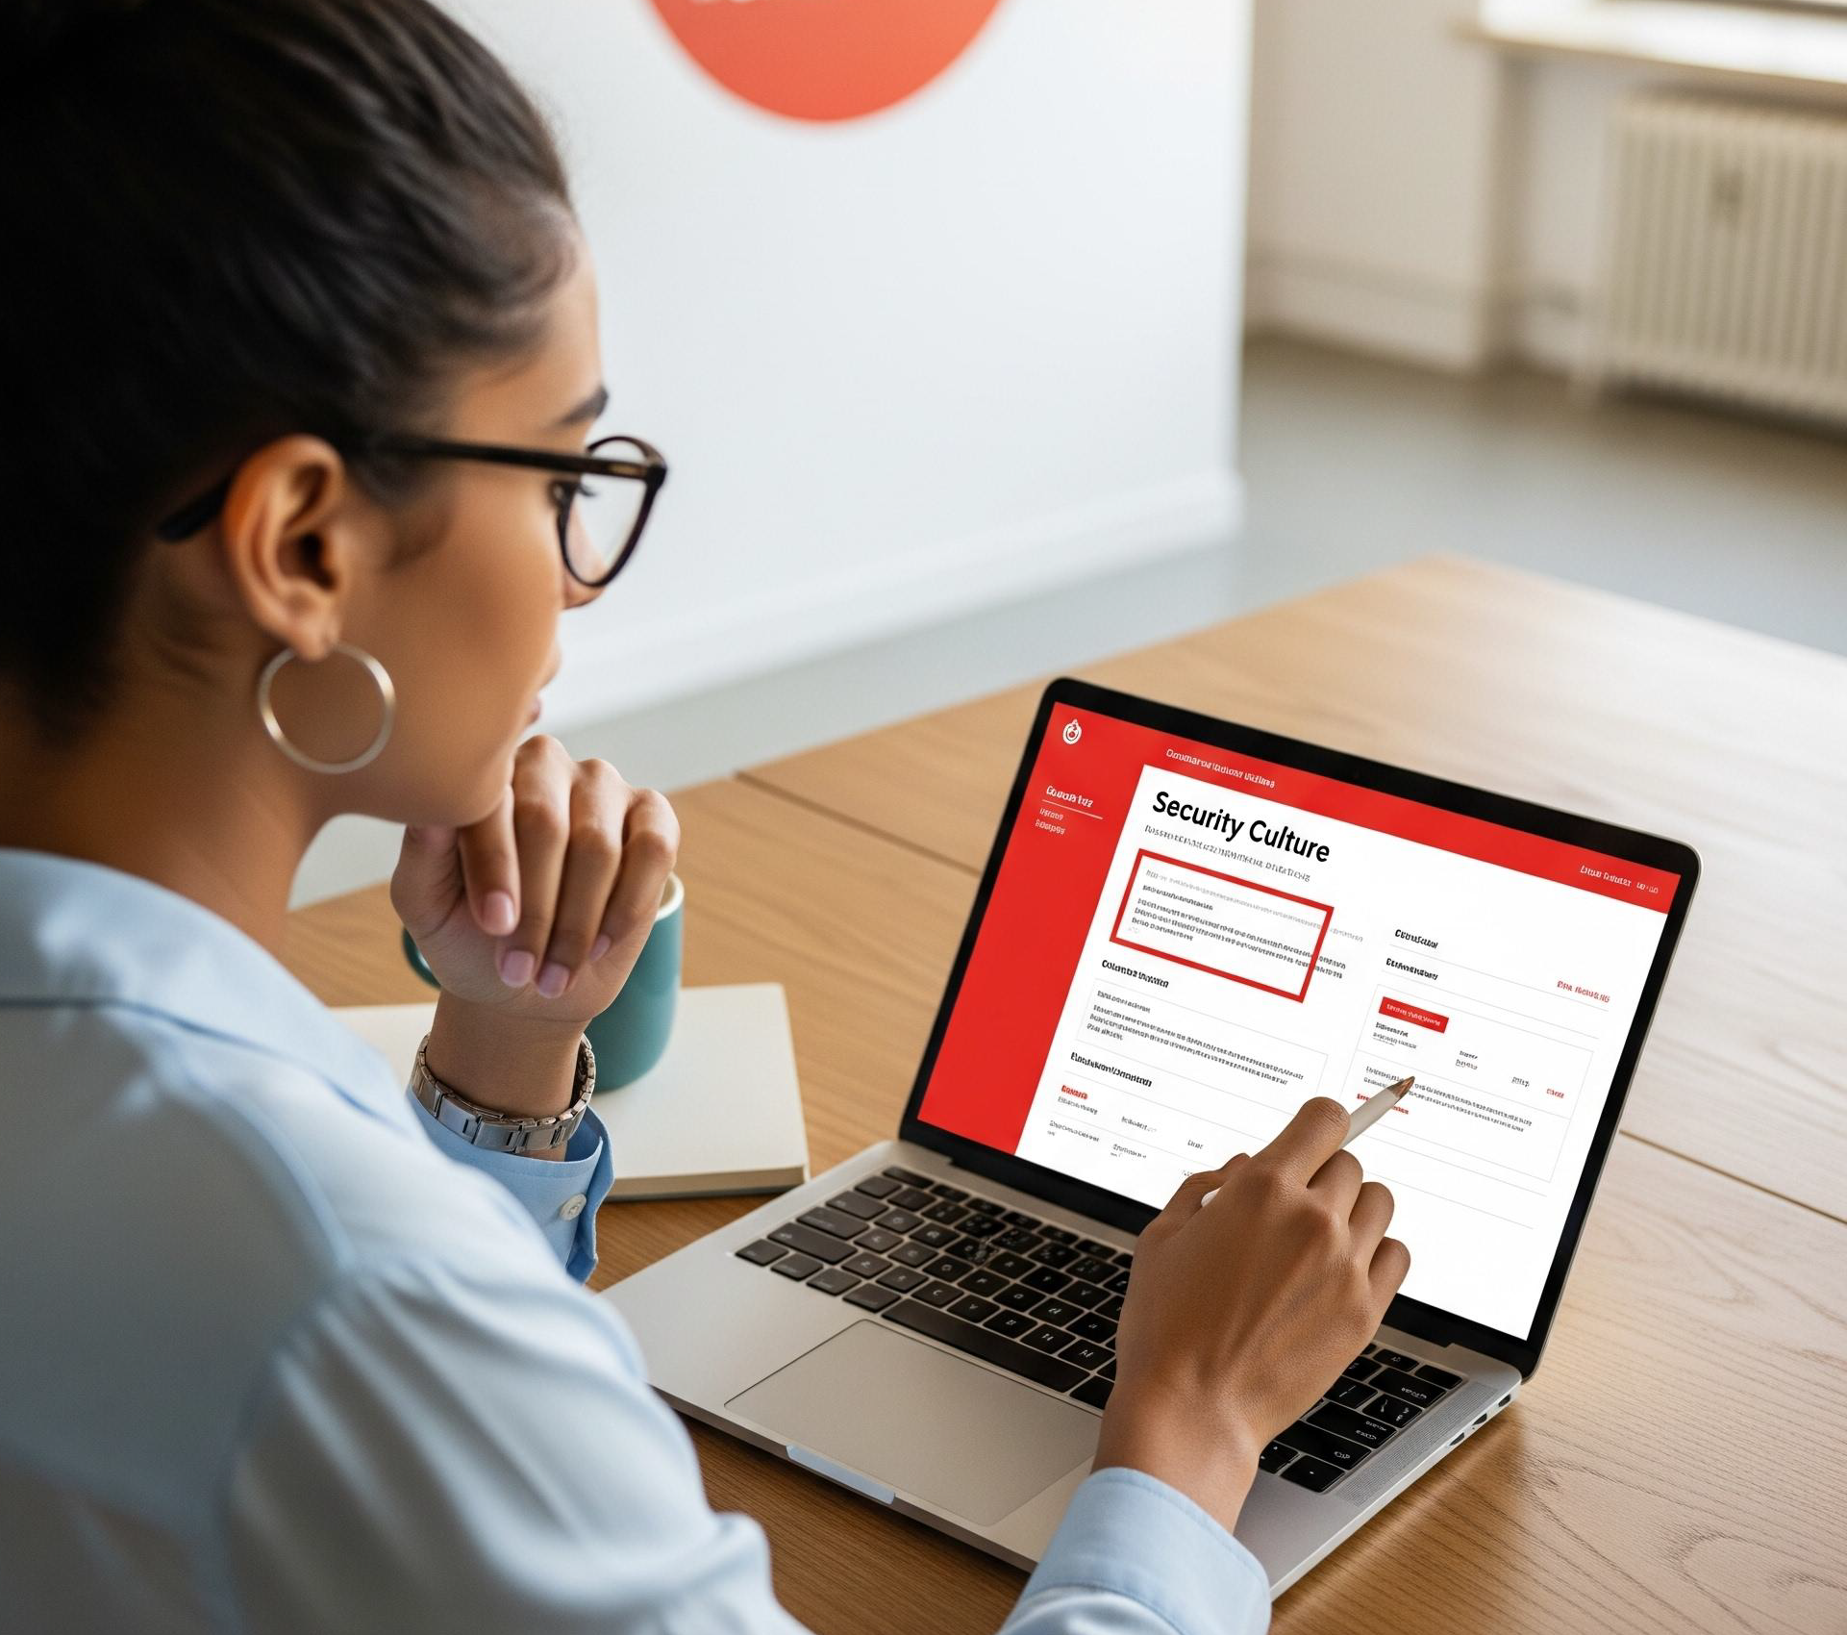
Security Culture Survey
Assess your organization's security culture
Your survey results will provide you with:
An overview of the seven dimensions that make up your security culture
Overall security culture score for your organization
Compare Industry Benchmarking
Use this information to establish a baseline for your security culture, determine changes to make to your security protocols, and to measure how your security culture evolves over time!
© 2026 KnowBe4, Inc. All rights reserved.

Slide 20
Expansion

Slide 21

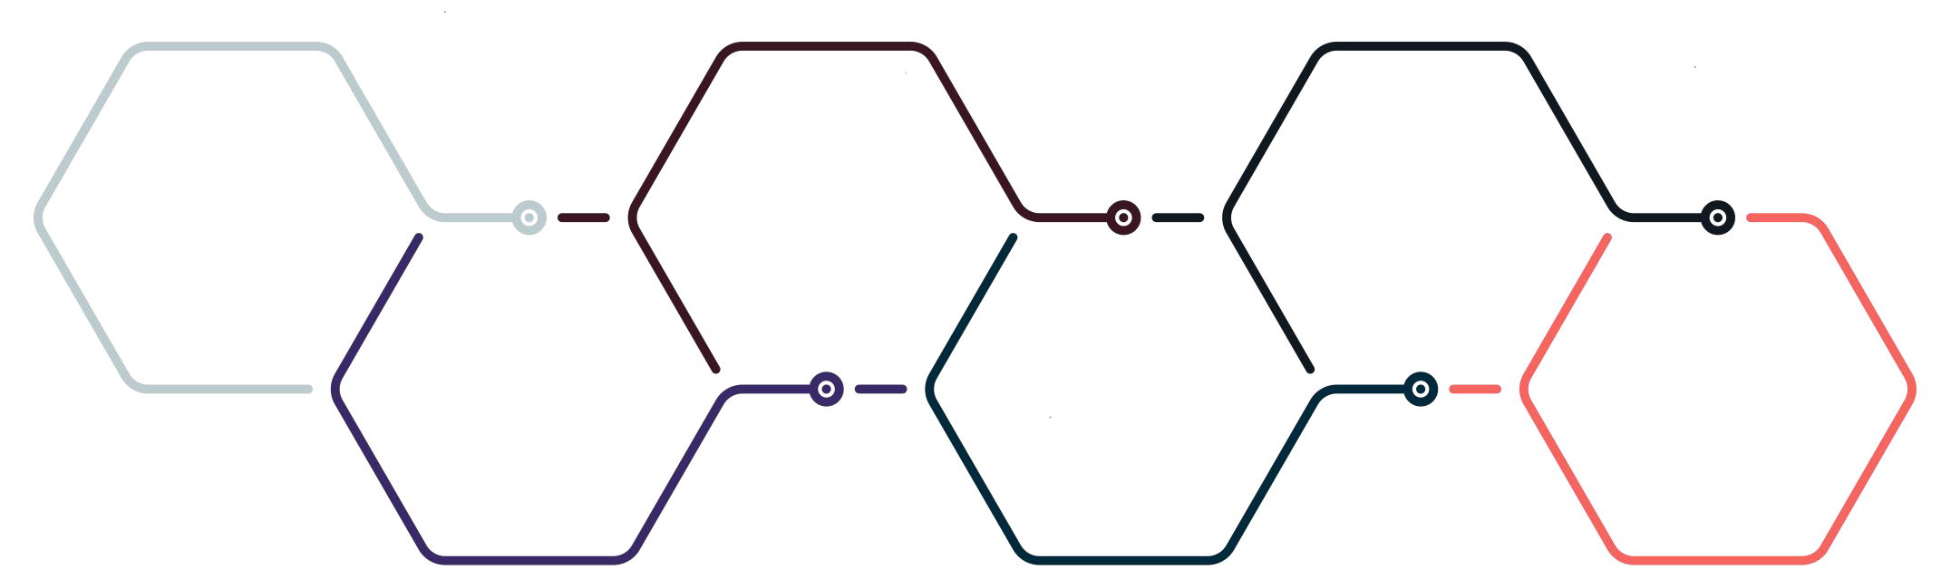

One Platform for Human Risk Management
The HRM+ platform includes modules for awareness and compliance training, cloud email security, real-time security coaching, crowdsourced anti-phishing, AI Defense Agents and more. As the only global security platform of its kind, KnowBe4 transforms your largest attack surface—your workforce—into your biggest asset, actively protecting your organization against cybersecurity threats.
Security Awareness Training
+
Anti- Phishing
+
Compliance Training
+
Cloud Email Security
+
Real-Time Coaching
+
AI Defense Agents
=
HRM+ Personalized. Relevant. Adaptive.

Slide 22
Resources

Slide 23

Universal Security Ecosystem
01 Coordinate a quarterly call with all agencies willing to join
03 Content Specialist will provide new content offerings and future roadmap items
02
Calls will includes latest updates, and feedback from the team
04
New Product exploration

Slide 24






What is The Inside Man?
The Inside Man series started out as a challenge: ‘is it possible to create a drama about information security that rivals anything seen on Netﬂix?’
From social engineering, CEO fraud and physical security, to social media threats, phishing and password theft, 'The Inside Man' reveals how easy it can be for bad actors to trick users like yours and wreak havoc in your organization.
GET THE INSIDE SCOOP:
https://www.knowbe4.com/inside-man-webinar-odw
https://insideman.knowbe4.com/

Slide 25

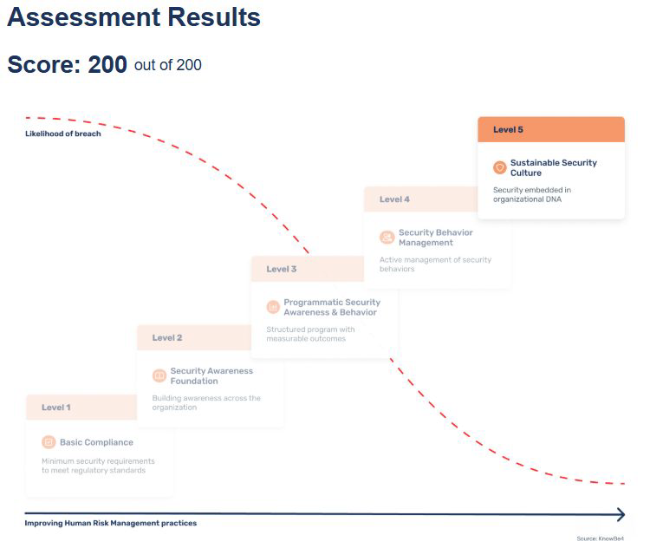
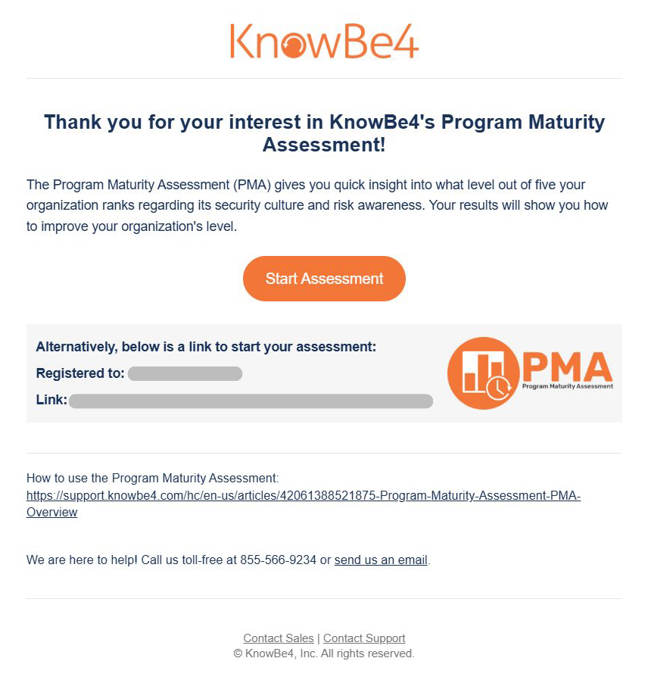

Program Maturity Assessment Tool
Created by security culture expert Perry Carpenter, the PMA offers a structured, practical self-assessment framework focused on Human Risk Management (HRM).
KnowBe4’s Program Maturity Assessment tool measures and strengthens an organization’s security culture across critical human risk dimensions. As human actions are targeted and exploited by attackers with increased sophistication, organizations need clarity on what is working and how to measure improvement.
“Your employees’ knowledge, beliefs, values, and behaviors will be the difference between protection and breach.”
https://www.knowbe4.com/free-cybersecurity-tools/program-maturity-assessment

Slide 26






KnowBe4 Home Course
Identify…
What security awareness is and why it’s essential to your online safety
Understand…
How cybercriminals use common tactics to mislead and manipulate you
Bring security home with you; learn how cybercriminals target your personal accounts and what measures you can take to protect your information and your family with the KnowBe4 Security Awareness for Home module.
Learn…
What you can do to protect yourself and those closest to you from cyberattacks
https://www.knowbe4.com/homecourse

Slide 27
KnowBe4 Academy!
KSAT 101
Learn how to implement security awareness training (SAT) and simulated social engineering campaigns for your users to minimize potential data breaches.
The KnowBe4 Academy is an education platform where admins can learn how to successfully use and integrate KnowBe4’s products. In the academy, admins can follow various learning paths for different areas of KnowBe4, including KSAT, PhishER, and SecurityCoach.
On the Home page, you can view our introductory courses, such as KnowBe4 101and PhishER 101.
PhishER 101
Learn how you can identify and respond to reported email threats faster and automate your email incident response plan.
View our Knowledge Base, connect on the
KnowBe4 Community, or go to KnowBe4.com.
On the Topics page, you can view all of your learning topics organized by category. You can even click Follow to receive notiﬁcations when new lessons are added to the topic.
Free Tools 101
Learn about KnowBe4’s free tool offerings, including the Phish Alert Button (PAB) and Automated Security Awareness Program (ASAP).
The Library page allows you to view all of your academy content.
https://support.knowbe4.com/hc/en-us/articles/37153516648851-KnowBe4-Academy-Guide

Slide 28

Knowbe4 Conference KB4-CON 2026
Date & Location
Join us May 12-14, as we transform the stunning Orlando World Center Marriott into a buzzing hub of cybersecurity excellence for KB4-CON 2026.
Agenda
We have an overview agenda available now. Our full agenda with keynotes and breakout sessions will be released in early 2026 and will be posted on the site below.
https://knowbe4.cventevents.com/event/5d3dfce6-ccb0-482d-83bb-0481ea07617f/summary
© 20265 KnowBe4, Inc. All rights reserved.
26

Slide 29






Create a Cyber Champions Program
The Human Factor
Build a Team
Due Diligence
Leadership Buy-in
Monitoring
Awards for Employees
Champion programs are a great way to have advocates spread across the organization who can further translate and embed the security message within your organization.
Due diligence should be taken to clearly understand and outline any differences with existing or similar programs.
Ensure that you have leadership buy-in from your CISO to CEO. They will be the best advocates for their business units.
Create a points based system that allows you to rank champions based on various criteria.
Certificates, security related gifts and/or gift cards based on level of participation. Peer recognition and/or acknowledgement or organizational swag.
https://www.knowbe4.com/hubfs/7-Steps-Implement-Security-Champions-Program

Slide 30



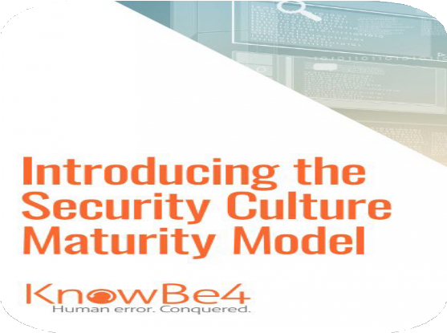
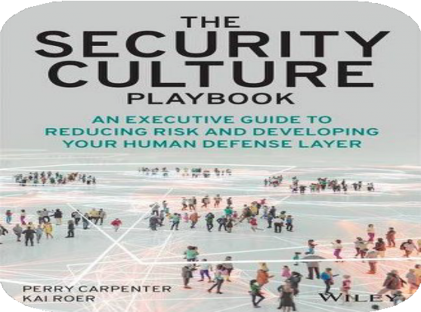


Security Culture Maturity Model - What is it?
Security Culture
is deﬁned as the ideas, customs and social
behaviors of a group that inﬂuence its
security.
Security Culture Maturity Model
is an evidence-driven framework for understanding and benchmarking the current security related maturity of an organization.
https://www.knowbe4.com/hubfs/Security-Culture-Maturity-Model
© 2026 KnowBe4, Inc. All rights reserved.
28

Slide 31
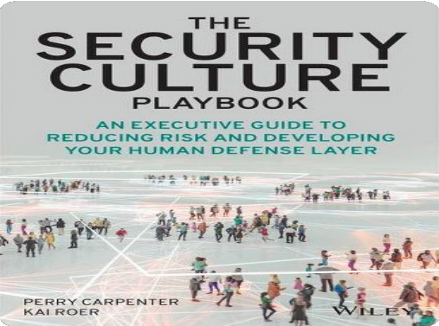
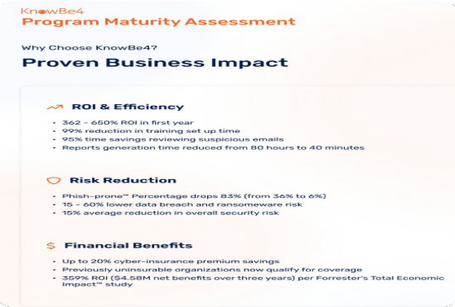
Security Culture Maturity
Security Culture Maturity Model
Security Culture is deﬁned as the ideas, customs and social behaviors of a group that inﬂuence its security.
Developed by Perry Carpenter and Kai Roer, the Security Culture Maturity Model is an evidence-driven framework for understanding and benchmarking the current security related maturity of an organization.
Program Maturity Assessment
The KnowBe4 Program Maturity Assessment (PMA) is a strategic tool that transforms how you measure and improve your security culture.
Created by security culture expert Perry Carpenter, the PMA provides actionable insights across ten critical dimensions with a clear maturity roadmap.
© 2026 KnowBe4, Inc. All rights reserved.
29

Slide 32









KnowBe4 Community
The KnowBe4 Community is a private online user community designed for you to connect, share knowledge, and collaborate on new ideas.
News
Ideas
Events
Explore
https://support.knowbe4.com/hc/en-us/articles/15480944821395-KnowBe4-Community-Guide
© 2026 KnowBe4, Inc. All rights reserved.

Slide 33











Gamiﬁcation
LX
Phishing Tournament
Engage your users by recruiting volunteers for a phishing tournament!
The Golden Phish Contest
Keep your users on the edge of their seat looking for the Golden Phish!
The Badge Collector Contest
How many badges can your users collect from taking training?
Take a Chance! Play Year Round
Incentivize your users by implementing a point system for monthly phishing tests!
https://helpimg.s3.amazonaws.com/KMSAT/CAM24-GamiﬁcationOptions.pdf
© 20265 KnowBe4, Inc. All rights reserved.

Slide 34
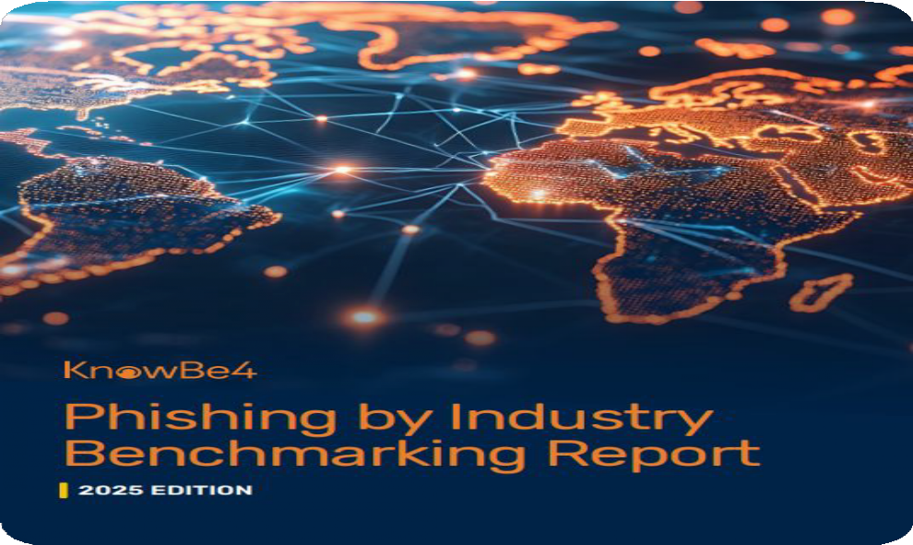
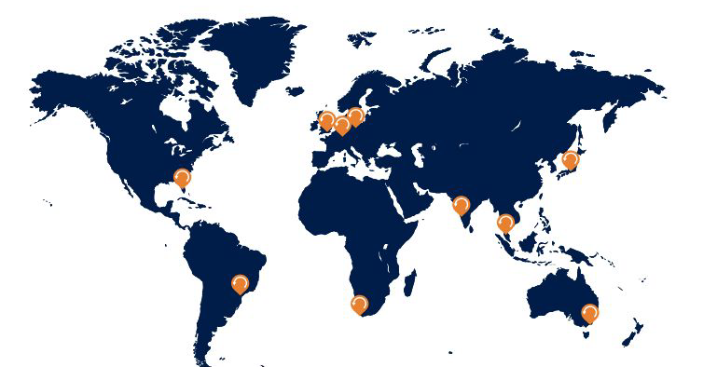
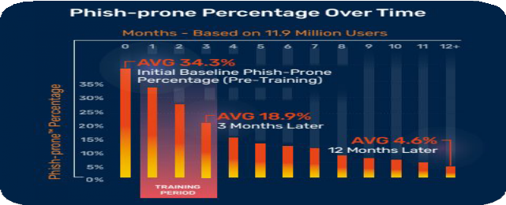
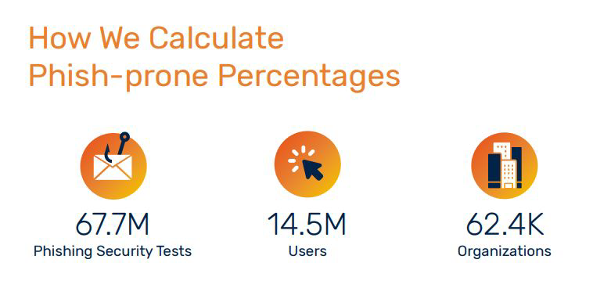
Phishing by Industry Benchmarking 2025
The median time to click on a malicious link in a phishing email is just 21 seconds.
This means you have less than half a minute for an employee to realize what they’re about to do.
https://www.knowbe4.com/hubfs/2025-PIB-Analyzing-Training-Report_EN-US.pdf
32

Slide 35

Thank you for your partnership!
Keeping You Informed. Keeping You Aware.
Stay on top of the latest in security including social engineering, ransomware and phishing attacks.
https://blog.knowbe4.com/
33

Slide 36
2025 COV SIRT Tabletop Exercise
Zachary Wilton
1/07/2026

Slide 37
Table of Contents/
Agenda
Introduction
  MSI SIRT Overview
2025 Exercise Review
  Summary
  Strengths
  Weaknesses
Plans for 2026

Slide 38
Introduction

Slide 39
MSI SIRT Overview
Manager: Stephone Dixon
Email: msi-security-operations@saic.com
Main Functions:
  Manage/Coordinate all actions related to Security Incidents, such as ticket escalations and bridge calls
  Insure proper documentation for all Security Incidents
  Review Security Incident Response processes, playbooks, and other documentation
  Coordinate the yearly COV SIRT Tabletop Exercise
Operations:
  Operational hours of 7AM-7PM Weekdays, 24x7 On-Call coverage
  Work in sync with the MSS SOC and VITA IR Teams for all Security Incident related matters

Slide 40
2025 Exercise Overview

Slide 41
2025 Exercise Summary
Participation:
  25 Agencies
  112 Individual participants
Structure:
  16 Cyber Security Scenarios were emailed and presented to all participants in total
  20 minutes per scenario (total exercise time of 6 hours, including breaks)
    Additional discussion questions were presented at each half-way point (10 min)
    2 Scenarios were walked through by the SIRT instead of discussion questions
  Key Topics: Nation-State Attack, 3rd Party Vendor/Supply Chain Attack, AI-Based Attack

Slide 42
2025 Exercise Summary
Example 1:
  A 3rd party SaaS critical to your organization reported that they had been victims of a data breach. Specifically, their OAuth tokens had been obtained by an attacker, and they believe that your organization may be at further risk. There have been no clear indications of information disclosure yet.
Example 2:
  A manager at your organization thought it would be a great idea for team building to have a shared fishtank for employees to take care of. To help kick start the process, they brought in a bunch of supplies such as food, a filter, and even a fancy new smart thermometer to ensure the team pet stayed safe and healthy. A few days later, a security analyst reviewed an alert within the SIEM that indicated successful data exfiltration to an unknown device on the network. Further analysis of the data showed that it contained PII and that the data stream was extremely slow, but consistent.

Slide 43
2025 Exercise Summary
Feedback Form Numbers (Rated from 1-5):
  Overall usefulness of the exercise: 4.3
  Relevance of Scenarios to your role: 4.2
  Clarity of instructions and materials: 4.2
  Quality of discussion and engagement: 4.3
  Value of lessons learned: 4.3
  Helpfulness in understanding incident response procedures: 4.3
  Realism and relevance of scenarios: 4.8
  Confidence in your team’s ability to respond to similar real incidents: 4.6
  Clarity of roles and responsibilities during the exercise: 4.2
  Format (tabletop) was effective for learning and collaboration: 4.7
  Scenarios encouraged meaningful discussion and collaboration: 4.4
  Communication during the exercise was clear and effective: 4.5

Slide 44
2025 Exercise Summary
Strengths
Weaknesses
Scenarios felt relevant, useful, and timely
Format was easy to follow and promoted internal team dialogue
Time allocated for scenarios (20 min) was “just right” by overwhelming majority of feedback
Confusion on expectations:
  Pre-exercise instructions
  Post-exercise deliverables
Invitation:
  Earlier invitation notices/instructions
Content:
  More “compounding” scenarios that play off each other
  More specific details/steps for scenarios
  More role specific responses/actions

Slide 45
Plans for 2026

Slide 46
Plans for 2026
Multiple Exercise Dates:
  At least 2 (possibly 3) chances to sign-up this year
  Shorter, but more interactive
  Most likely will have limited sign-ups (more details will come ASAP)
Format Changes:
  Lower number of scenarios – more details on the specific IR steps
  Less focus on the email responses – more emphasis on live interaction
  Expect more details on the next presentation….

Slide 47
2026 Server operating system (OS) refresh
John C. Del Grosso
January 7, 2026

Slide 48
Discussion today
New Operating System Version Release Announcement
VITA Enterprise Architecture Roadmap & Support Durations
Support Model Timelines (Windows Server and Linux)
Refresh initiation
Calendar year 2026 OS Refresh Planning

Slide 49
COV server upgrade progress
Agencies have done a great job in 2025 in upgrading and decommissioning older operating system versions. Thank you!
Year 2026 will be a continuation of upgrading and decommissioning non-supported or nearly end-of-support operating system versions.
VITA appreciates your diligence, support and participation in the OS upgrade program.

Slide 50
VITA Enterprise Architecture Roadmap Support Durations
Linux General Release
Full / Premier Support / Branch Releases
End of Service Life (EoSL)
Extended Life Phase
End of Life
(EoL)
Microsoft General Release
Mainstream Support
Extended Support
End of Service Life (EoSL)
Extended Security Updates
End of Life
(EoL)
5 Years
Security patching- all
Enhancements
Features Updates
Enhanced Support
Warranty Support
5 Years
Security patching - all
Enhancements
Enhanced Support
Warranty Support
KBA updates
3 Years
Security patching
  Critical
  Informational
Paid support
“Best effort” support
No Security
"Best Effort" Support
Covered by VITA Enterprise Support Agreements
Purchased ESU Licensing

Slide 51
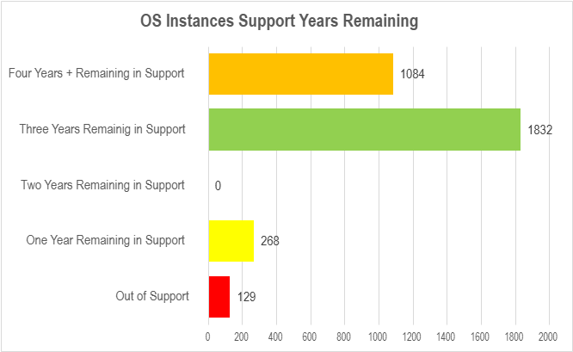
OS Upgrade “Gap Year” and Upgrade Relief Opportunity
The operating system release and upgrade cadence has provided an opportunity for a “gap year”
Upgrade relief for OS2019 and Linux 8 instances in 2026
Current N through N-2 versions are in full support in the environment for the next three years or more.
2026: Concentration on end-of-support and approaching end-of-full-support OS versions

Slide 52
Upgrade choices for 2026
All Windows Server 2019 (N-2) instances can remain without the EA-225 upgrade requirement to N or N-1 through calendar year 2026.
All Linux Server 8 and Oracle Linux 8 (N-2) instances can remain without the EA-225 upgrade requirement to N or N-1 through calendar year 2026.
If an Agency needs or prefers to upgrade existing OS2019, Red Hat 8, or Oracle Linux 8 to N or N-1, contact your BRM or VITA SSDC Service Owner for planning. Please do not submit a Service Request.
  These upgrades remain at no cost but will be planned outside the usual ARCP Project processes.

Slide 53
Windows and Linux upgrade project in 2026
In calendar year 2026, the ARCP OS upgrade project will concentrate efforts on upgrading and remediating OS N-3+ versions:
Microsoft Server | Instances Remaining | Red Hat Enterprise | Instances Remaining | Oracle Linux | Instance Remaining
2008 (N-5) | 2 | RHEL 5 (N-5) | 2 | OL 5 (N-5) | 5
2012 (N-4) | 58 | RHEL 6 (N-4) | 38 | OL 6 (N-4) | 0
2016 (N-3) | 210 | RHEL 7 (N-3) | 40 | OL 7 (N-3) | 40
395 Total Instances in N-3 to N-5

Slide 54
Microsoft OS support
Windows servers in full support
Server version | Mainstream support end date (first 5 years) | ESU end date (+3 years) at additional cost
Windows Server 2025 (N*) | Oct. 11, 2035 | Oct. 11, 2038
Windows Server 2022 (N-1) | Oct. 14, 2031 | Oct. 14, 2034
Windows Server 2019 (N-2) | Jan 9, 2029 | Jan 9, 2032
* Upon release in March 2026
Windows servers ending or out of full support
Server version | Extended support end date (end of 10-year support) | ESU end date (+3 years) at additional cost
Windows Server 2012 (N-4) | Oct 10, 2023 | Oct 10, 2026
Windows Server 2016 (N-3) | Jan 12, 2027 | Jan 12, 2030

Slide 55
Linux-based OS support
Linux releases branches through the support cycle, which can change the support profile.
Linux servers in Premier/Full support
Server version | Premier Support Ends (first 10 years) | Extended support end date (additional 3 years)
RHEL/Oracle Linux Version 10 (N*) | June 2035 | June 2038
RHEL/Oracle Linux Version 9 (N-1) | June 2032 | June 2035
RHEL/Oracle 8 (N-2) | July 2029 | July 2032
* Upon release in March 2026
Linux servers out of Premier/Full support
Server version | Premier Support Ended (first 10 years) | Extended support end date (additional 3 years)
RHEL/Oracle Linux Version 6 (N-3) | March 2021 | December 2024
RHEL/Oracle Linux Version 7 (N-4) | December 2024 | July 2029

Slide 56
Big News! Microsoft Server 2025 & RHEL/OL 10 Release
Server 2025/RHEL-OL10 is moving through the security hardening process and is expected to be available to agencies by March 2026
New or update server requests available on the service catalog in March
Microsoft Windows: OS2022, OS2025
RedHat and Oracle Linux: Linux 9, Linux 10

Slide 57
Extended Security Updates
Server 2012 is in its final year of extended security updates (ESU), ending October 2026
After October 2026, OS2012 will be end-of-life with no support
56 remaining instances of OS2012
Server 2016 is in its last year of full support, ending January 2027.
Extended support through ESU is expected to be available starting in January 2027
  ESU has not yet been announced by Microsoft
210 remaining instances of OS2016
Azure Arc agents to be deployed to OS2016 servers during 2026 to be ready for OS2016 ESU
ESU is a cost item to the Agencies – avoid the cost by remediating!

Slide 58
Refresh project initiation
We have, for the first time, two environments managed by two different suppliers. Each have different upgrade paths and processes:
Managed by Unisys via ARCP Project
  Commonwealth of Virginia (COV) data centers (VMWare, PCA, Physical)
  Oracle Cloud Infrastructure (OCI) public cloud
  Amazon Web Services (AWS) public cloud
    Agencies will be contacted by the Unisys ARCP project manager
    Contact your BRM or VITA SSDC Service Owner for upgrade activity
Managed by NTT Data via RFS/DMND
  Microsoft Azure Public Cloud
    DMND for upgrade is zero-cost unless there are other non-upgrade activities added

Slide 59
Types of OS Upgrades
In-place upgrades:
The existing server is upgraded to a new version.
In-place upgrade should be discussed with the upgrade team first.
Duration: Typically, 4-6 hours, depending on complexity and patching updates needed. Snapshot taken with roll-back in minutes.
Testing: The agency should provide testers and server owner to be available after the in-place upgrade period.
In-place upgrades may result in vulnerability remnants of older OS versions, unsupported .NET versions, and former Agency apps remaining.
Physical server must still be in-support
New server migration:
The current server is replaced with a new server.
Agency request: A new server should be ordered through the service catalog.
Agency installs and tests applications.
Agency must submit "Decomm Request"
A server migration is advised if:
  Identified security vulnerabilities cannot be resolved due to end-of-life apps, non-supported app or tool versions
  The server cannot be upgraded by in-place means. Most often if upgrading 3 or more versions up from initial delivery.
  A physical server is end-of-support or end-of-life
Notes:
Speaking notes for server migration:
Agency must submit a decommission server catalog request when migration is complete.
Indicate which current server is being replaced, so the team can ensure the same firewall rules and environment are identical.
Agency will install all needed applications, conduct testing and determine when the old server can be decommissioned. Agency can elect to transfer data themselves or request Unisys, through a REQ ticket to transfer on-board data. This server will have a new IP assigned. If a specific IP is needed, please indicate the IP number on the Catalog Request.

Slide 60
Questions?

Slide 61
VITA Enterprise Architecture Roadmap & Linux Support Durations
General Release
Full / Premier Support
End of Service Life (EoSL)
Extended Life Phase
End of Life
(EoL)
No Security
No Support
10 Years
Security patching- all levels
Enhancements
Features Updates
Enhanced Support
Warranty Support
3 Years
Security patching
  Critical
  High
Paid support
Covered by Supplier Service Agreement
Purchased Extended Service

Slide 62
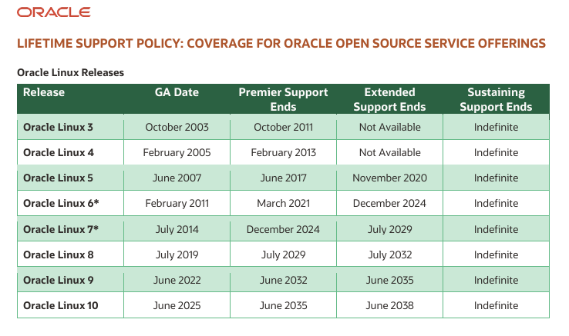
Oracle / Linux support policy
* Out of premier support

Slide 63
VITA Enterprise Architecture Roadmap & MS Support Durations
General Release
Mainstream Support
Extended Support
End of Service Life (EoSL)
Extended Security Updates
End of Life
(EoL)
5 Years
Security patching- all
Enhancements
Features Updates
Enhanced Support
Warranty Support
3 Years
Security patching
  Critical
  Informational
Paid support
“Best effort” support
5 Years
Security patching - all
Enhancements
Enhanced Support
KBA updates
No Security
No Support
Covered by VITA MSFT Enterprise Agreement
Purchased ESU Licensing

Slide 64
Okta SMS (text) and voice disablement
Luis Lugo
Service Owner
January 2026

Slide 65
Agenda
Status of disablement
Scheduling agency’s disablement of voice and SMS authentication
Resources available
Targeting external users

Slide 66
Status of disablement
VITA and three agencies have undergone disablement
Takeaways:
Communications to end-users
  Remember their passcode
  COV password vs. Okta Verify passcode
If possible, users should be in office if they are registering for a new authenticator
  Avoid any potential confusion with virtual private network connection
Some agencies have chosen to distribute YubiKeys

Slide 67
Scheduling agency disablement
Targeting agencies that have the highest adoption rate first based on users who have migrated to alternative methods
  80% and up adoption rate
  Agencies can select specific security groups to disable
The update will no longer make it possible for users to enable SMS and voice services and users that are using SMS and voice will
A message will be sent by business relationship managers (BRM) to agencies who are seen as ideal candidates
Once confirmation is provided, the change will be scheduled
  CHG# shared with BRMs
  End-user message available

Slide 68
Available resources
Recorded information session
VITA authentication services webpage
  Overview video
  Job aids
Suggested end-user message as your agency is scheduled
An update comm is being sent for lessons learned
A new knowledge base article on specific user scenarios is work-in progress (WIP)

Slide 69
Next steps - External users
COV accounts were first being targeted
When COV accounts show successful transition external users will be targeted
Cardinal dependency
  If connected to the COV network, Cardinal can be accessed regularly. This applies to users in office or connected via VPN.
  When not on the COV network, a mobile authentication app must be used. Okta Verify or Google Authenticator are available options for Android or iOS.
  Note: If and when additional authenticators become available, a communication will be sent.

Slide 70
Questions?

Slide 71

NCSR
Andrew Wirz
VITA CSRM Risk Management
Senior IT Analyst
January 7, 2026

Slide 72
NCSR Self-Assessment
Available in Archer ,completion required by end of February
Completed by agency ISO
Completion of this questionnaire will be part of the 2025 ‘overall risk score’ on the agency scorecard, replacing the previous IDS report score.
Thank you for your engagement.

Slide 73
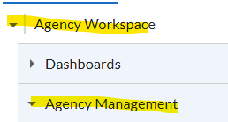
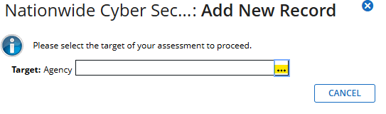
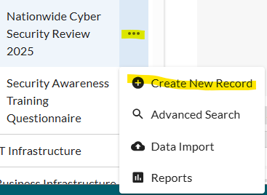

Screenshots, record creation

Slide 74

Announcements
ISOAG January 2026
Notes:
Example of when to use this slide background for a call out section and text

Slide 75


Top 5 Vulnerabilities
For the month of January, the Top 5 Key Vulnerabilities are:
Microsoft Edge (Chromium) < 142.0.3595.90 Multiple Vulnerabilities
Google Chrome < 143.0.7499.109 Multiple Vulnerabilities
KB5071417: Windows 11 version 22H2 / Windows 11 version 23H2
Security Update (December 2025)
Apache Log4j < 2.15.0 Remote Code Execution (Windows)
Oracle Java (Apr 2024 CPU)
*NOTE* Check CSRM Connections for more detailed information
vita.virginia.gov
Notes:
This slide background works best with text heavy sections, with no imagery OR when an Icon is used

Slide 76
Deliverables & dates for audit and risk compliance
Agency deliverable activity & schedule for 2025
For any questions, please have your ISO contact your assigned CSRM analyst or Erica Bland, the Governance & Compliance Manager.
CY25 Annual report data was pulled on December 31, 2025.
CSRM will accept CY25 deliverables until January 31, 2026.
Quarterly updates Audit & Risk Findings
Review and update Audit & Risk Plans as required
Complete Audit & Risk Assessments as required
Review & Update Business Impact Analysis & application certifications
Agency ISO need to complete their ISO certification requirements
Annual report data will be pulled on December 31, 2025.

Slide 77

Virginia Cyber Security Partnership (VCSP)
Who We Are
The VCSP is a non‑profit collaboration between public and private sector cybersecurity professionals.
Established in 2012 to create a trusted community for discussing cyber threats and sharing best practices.
Our Mission
Strengthen cybersecurity across Virginia through:
Education – K‑12 outreach, collegiate engagement, member workshops
Collaboration – Networking, mentorship, small‑business cyber support
Partnership – Working with law enforcement and supporting cyber policy development
Get Involved
VCSP is seeking volunteers to support mission programs and community initiatives.
Interested? Contact: Amy Braden – Director, IT Security Governance & Compliance (VITA)

Slide 78
Upcoming Events
vita.virginia.gov
Notes:
This slide is used as a transition title slide for a new section

Slide 79
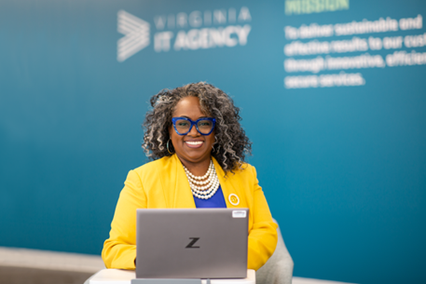
Upcoming Governance Office Hours
Governance Office Hours launched recently – a dedicated space for Agency ISOs and teams to bring their questions, concerns, or ideas directly to the Governance Team.
What to Expect:
Open discussion place
Governance Updates
Q&A and support for your needs
Next Session:
February 11, 2026 | Microsoft Teams
[Click here to register for the meeting]
Let’s work together to strengthen governance across the Commonwealth!

Slide 80

CyberConVA – February 12, 2026
rvatech/ CyberConVA 2026
Notes:
Please contact Amy Braden if you'd like to volunteer or know of folks who would like to serve as volunteers.

Slide 81

IS Orientation
The next IS Orientation is being held on February 25, 2026
  February 25th, from 9am to 4pm, registration closed February 9th.
  First IS Orientation of 2026
  It will be held in-person at the Boulders location:
  7325 Beaufont Springs Drive, Richmond, VA 23225
  Visit Commonwealth IS Orientation to register!
Notes:
This slide works best with photos and graphs/charts. Image and text can be reversed

Slide 82

Service Tower SOC Report Review Sessions
      To register for this meeting, please click on the link below: https://covaconf.webex.com/weblink/register/r908b477733bd7adfbace299c8e431e4c
The upcoming SOC review session is March 11, 2026, and will be held remotely.
Please register at the link below
Notes:
Example of when to use this slide background for a call out section and text

Slide 83


Public Sector Network:
Government Innovation Showcase Virginia
When: April 23, 2026
Where: Richmond Marriott Downtown,
Richmond, VA
Government Innovation Showcase Virginia - Event | Public Sector Network

Slide 84
MEETING ADJOURNED
Notes:
Title slide - Any text that looks black is HEX code 414042. If you have an idea for an image, let me know and I can provide you with one.

