Slide 1

Information Security Officer's
Advisory Group
WELCOME TO THE Sept 3, 2025
ISOAG MEETING

Slide 2

Agenda
Welcome/Opening Remarks | Kendra Burgess/ VITA
Impact of AI on information security practice and practitioners | Lionel Mew, Ph.D / University of Richmond
Cybersecurity Considerations During All-Hazards Incidents | Monroe Molesky / VDEM
Security Governance: Policies & Standards | Amy Braden / VITA
COV Tabletop Exercise 2025 | Zach Wilton / SAIC
Announcements and Upcoming Events | Kendra Burgess/ VITA
Adjourn
Agenda Presenter
vita.virginia.gov
Notes:
This slide background works best with text heavy sections, with no imagery OR when an Icon is used

Slide 3

The Impact of AI on Information Security Practice and Practitioners
How Artificial Intelligence is Transforming Cybersecurity as a Profession
Dr. Lionel Mew

Slide 4
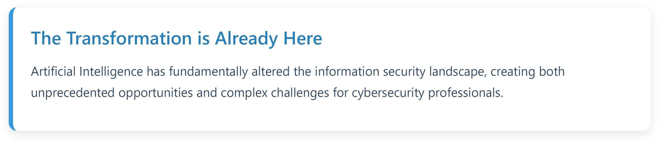
Executive Summary
2/16
Key Impacts
Threat actors leverage AI for sophisticated attacks
Strategic Imperatives
Upskill workforce in AI/ML technologies
Defensive capabilities enhanced through machine learning
Integrate AI tools into security operations
Develop AI governance frameworks
Professional skill requirements evolving rapidly
Prepare for future AI-driven threats
New vulnerability categories emerging

Slide 5
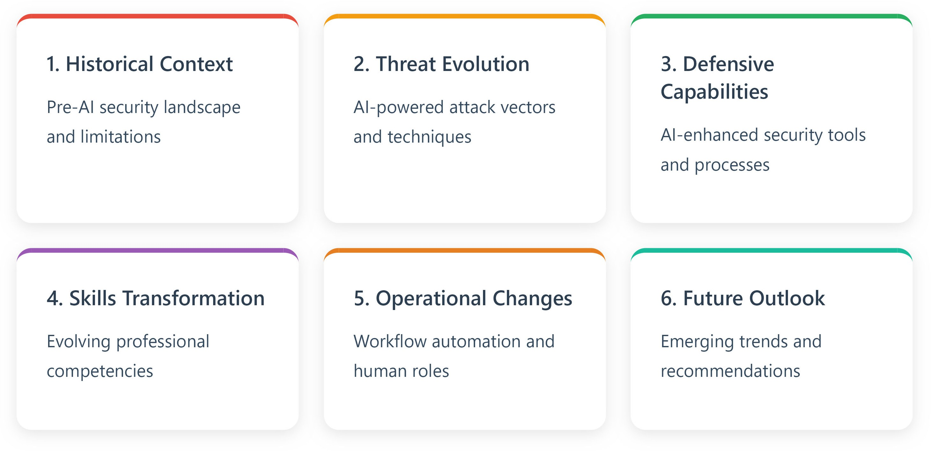
Presentation Agenda
3/16

Slide 6
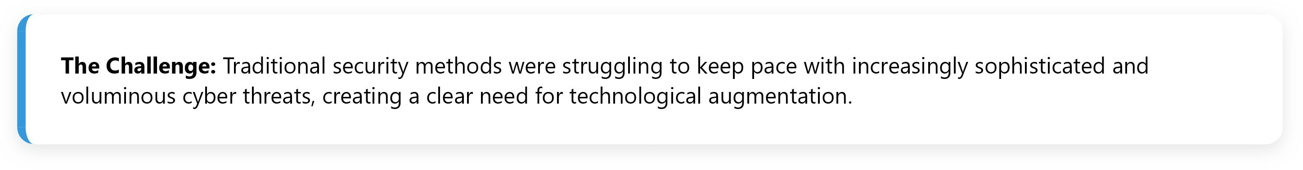
Information Security: The Pre-AI Era
4/16
Traditional Security Approach
Signature-based detection: Relying on known malware signatures
Rule-based systems: Static security policies and configurations
Manual analysis: Human-driven log review and incident response
Reactive posture: Responding to threats after they occur
Perimeter-focused: Network boundary security emphasis
Critical Limitations
Scalability issues: Human analysts overwhelmed by data volume
False positive rates: High noise-to-signal ratios
Detection lag: Slow identification of novel threats
Resource constraints: Limited 24/7 monitoring capabilities
Zero-day vulnerability: Inability to detect unknown threats

Slide 7
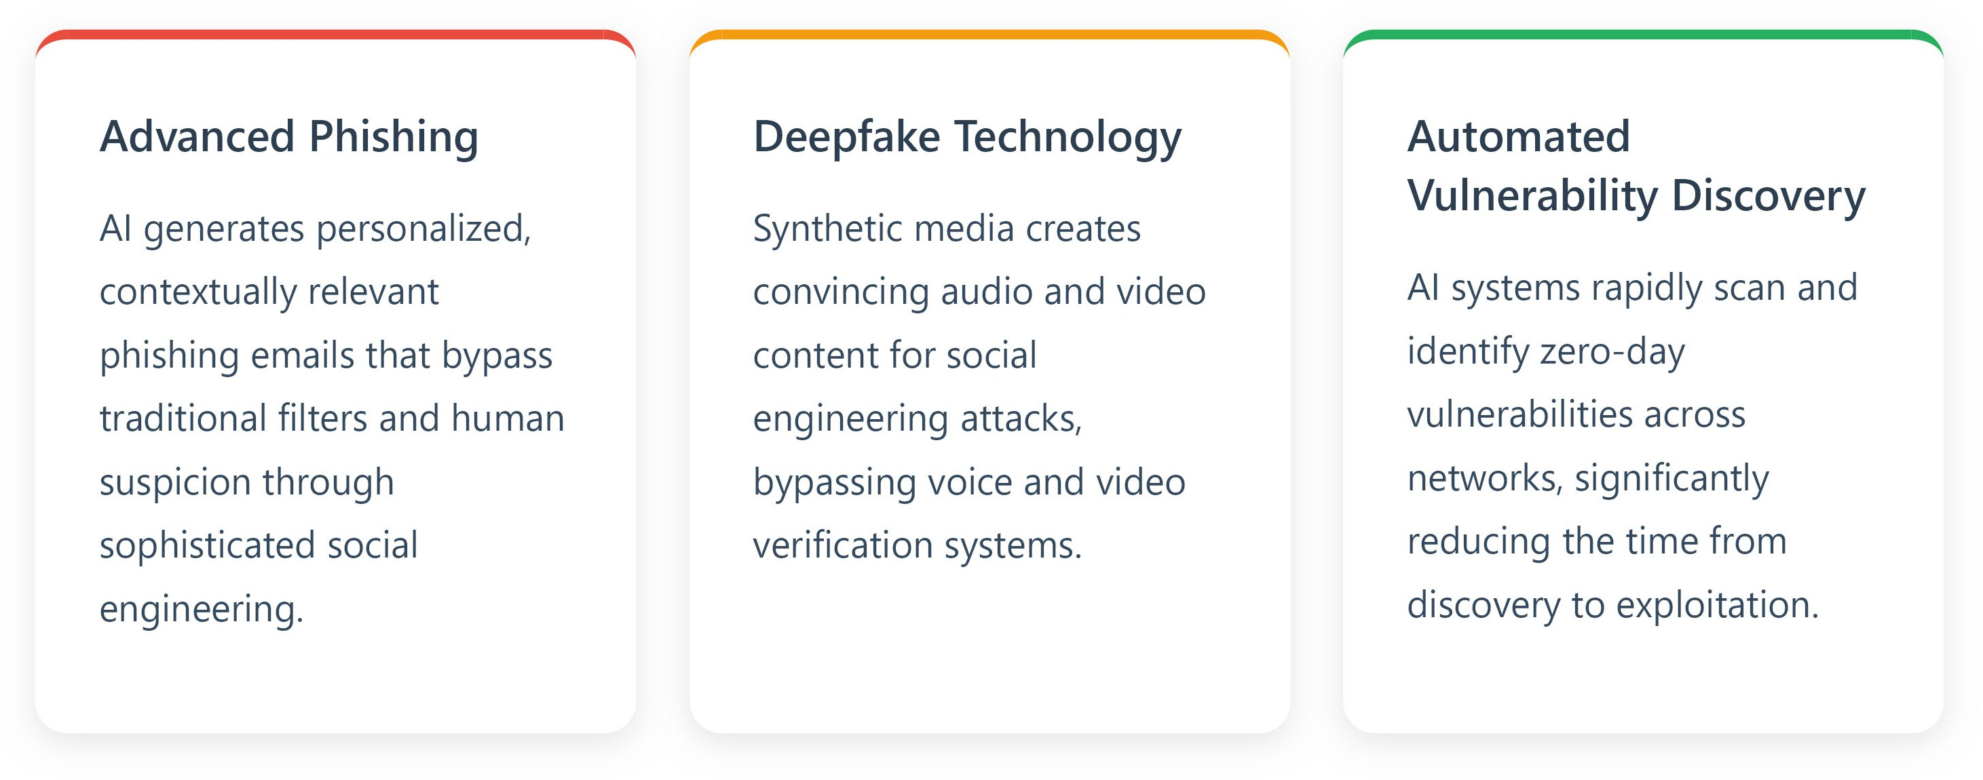
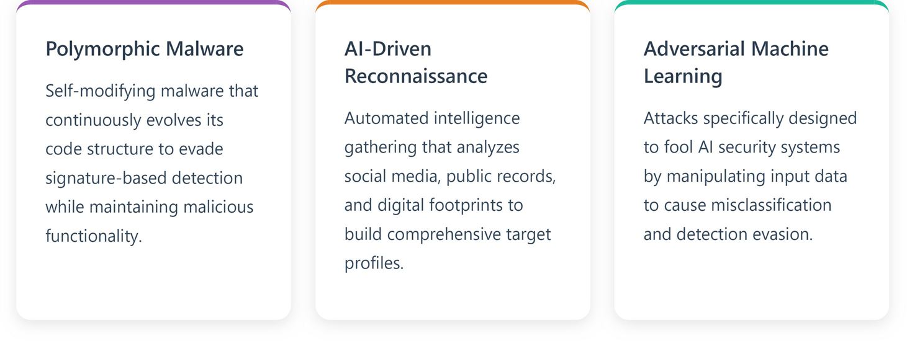
The Evolution of Cyber Threats
5/16
AI-Enhanced Attack Vectors

Slide 8
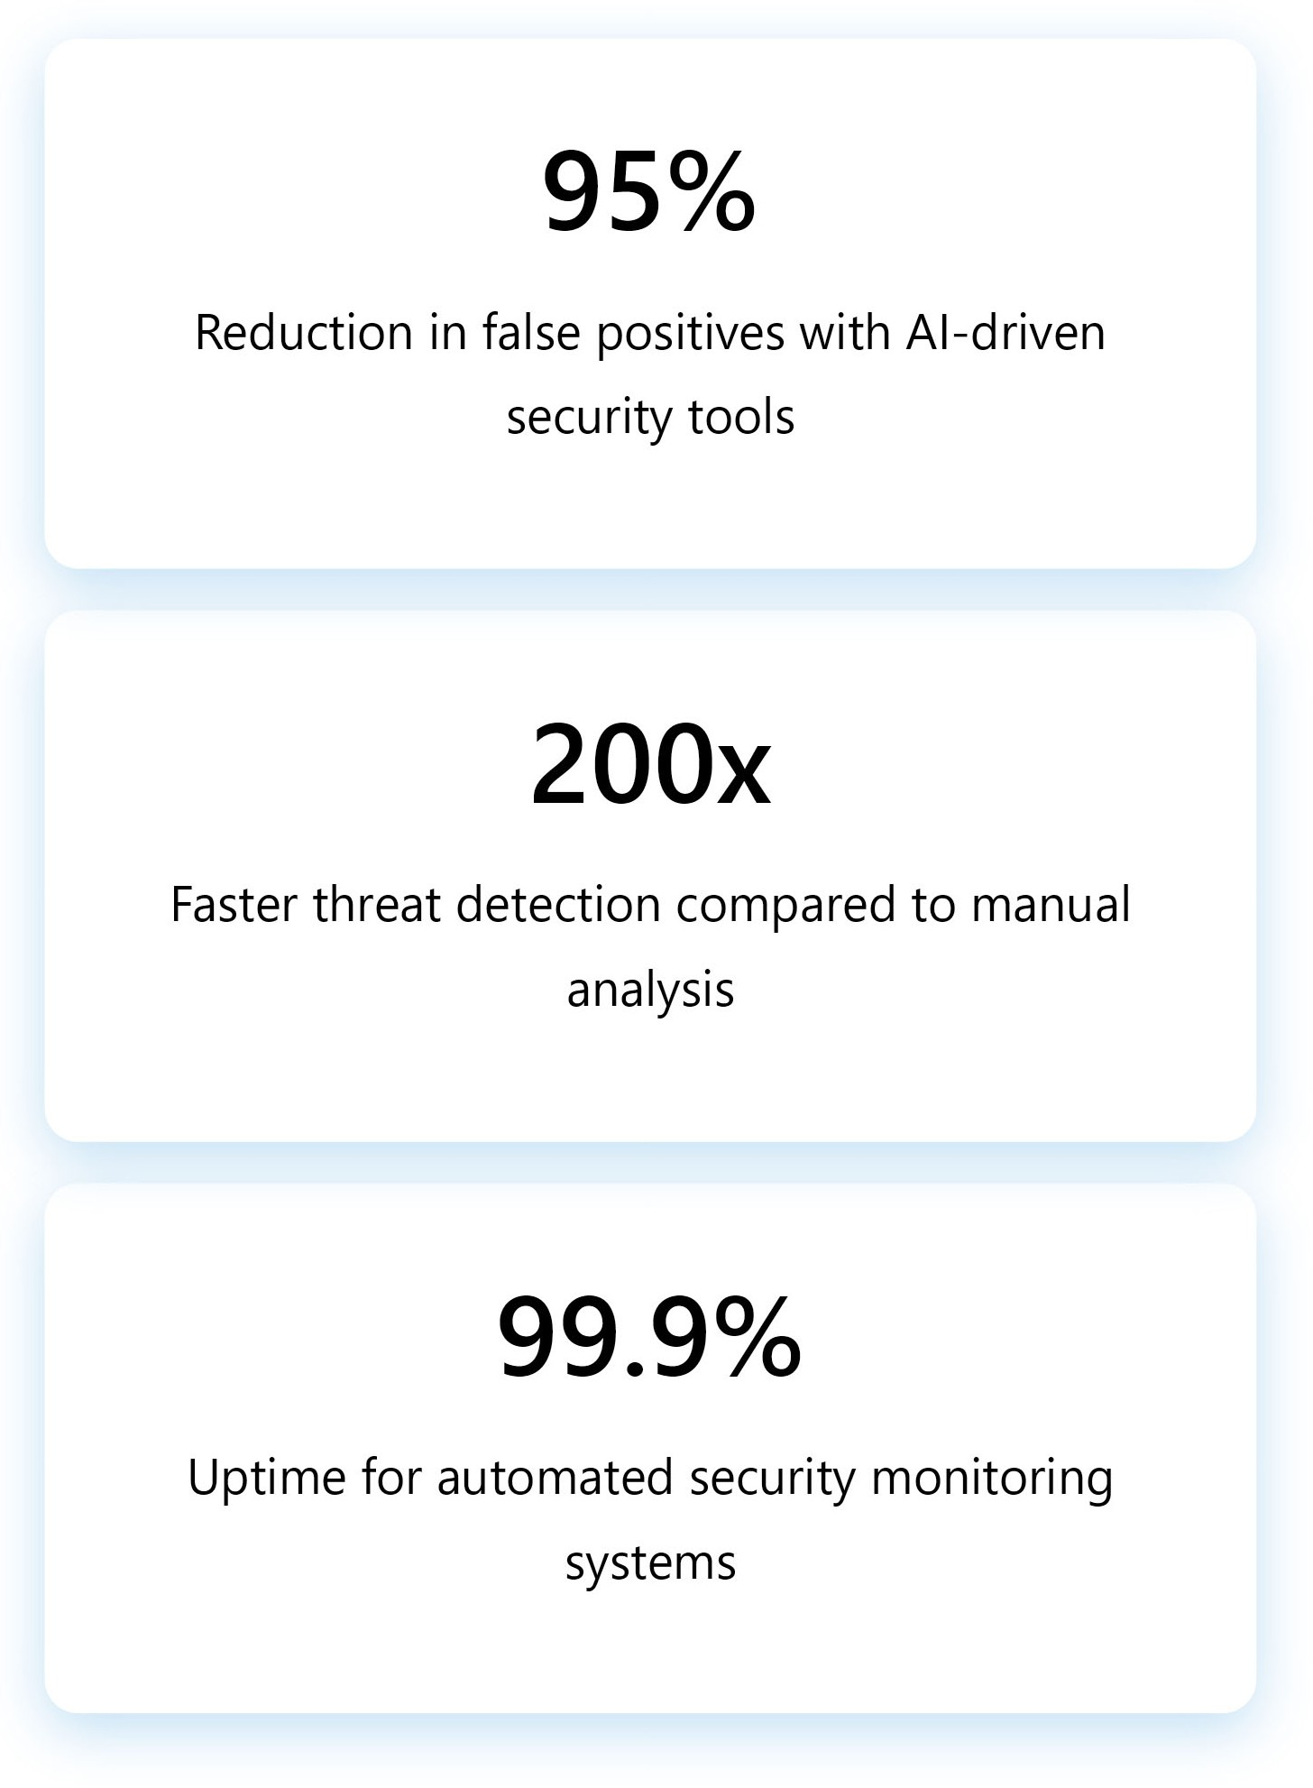
Revolutionary Defensive Capabilities
6/16
Real-Time Threat Detection
Behavioral Analytics: AI monitors user and system behavior patterns to identify anomalies
Network Traffic Analysis: ML algorithms detect suspicious communication patterns
Endpoint Protection: AI-powered antivirus adapts to new threats in real-time
Threat Intelligence: Automated correlation of global threat indicators
Predictive Security
Risk Assessment: AI predicts potential attack vectors before exploitation
Vulnerability Prioritization: ML ranks vulnerabilities by actual risk level
Threat Hunting: Proactive search for advanced persistent threats

Slide 9



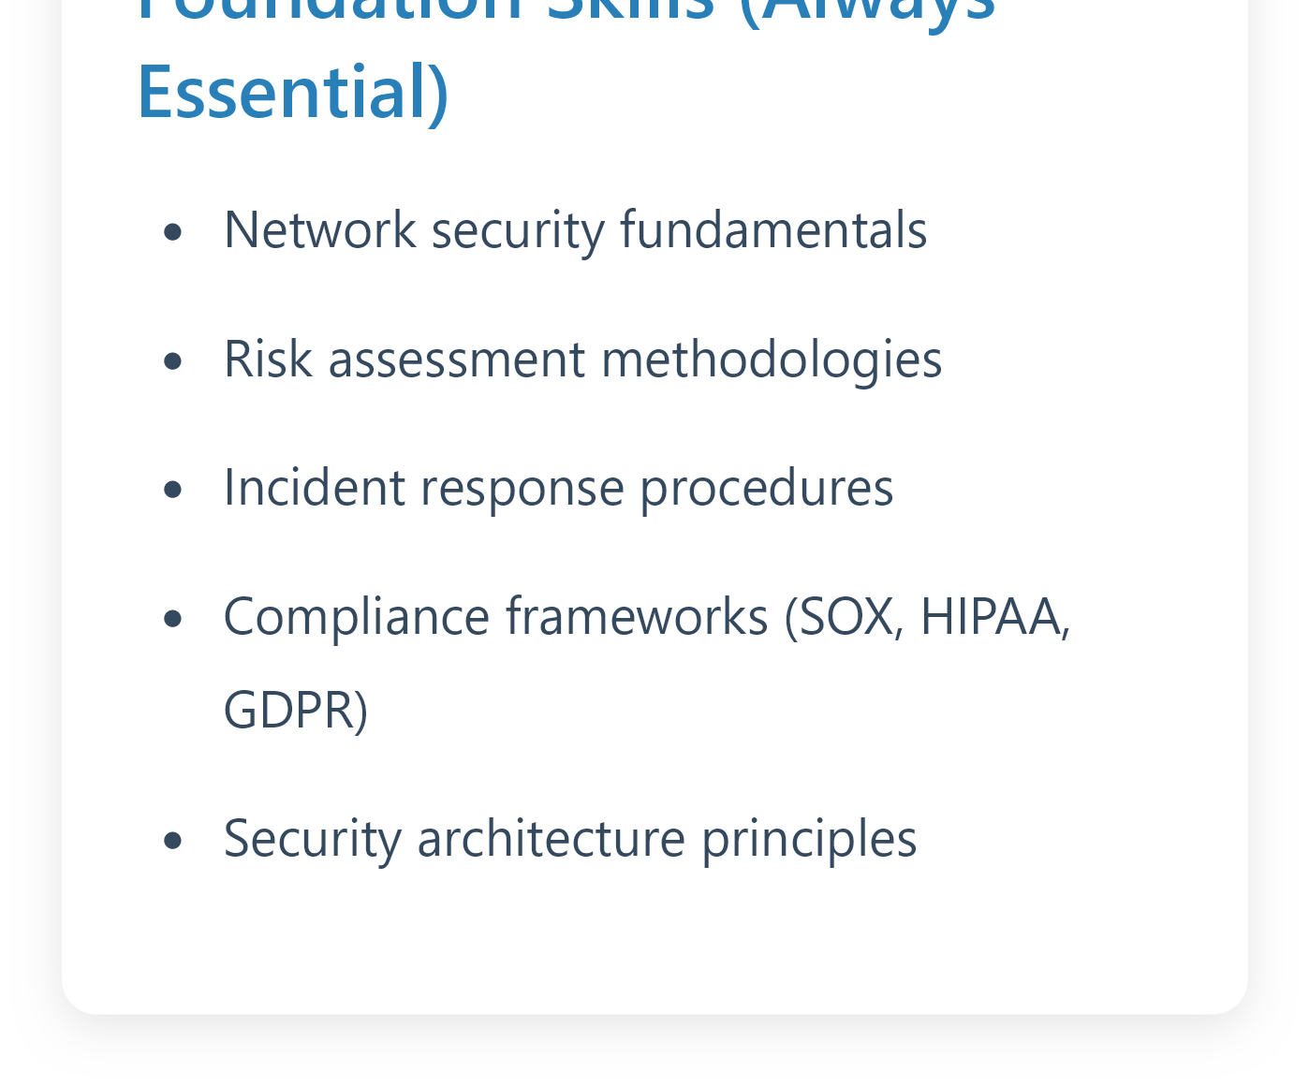

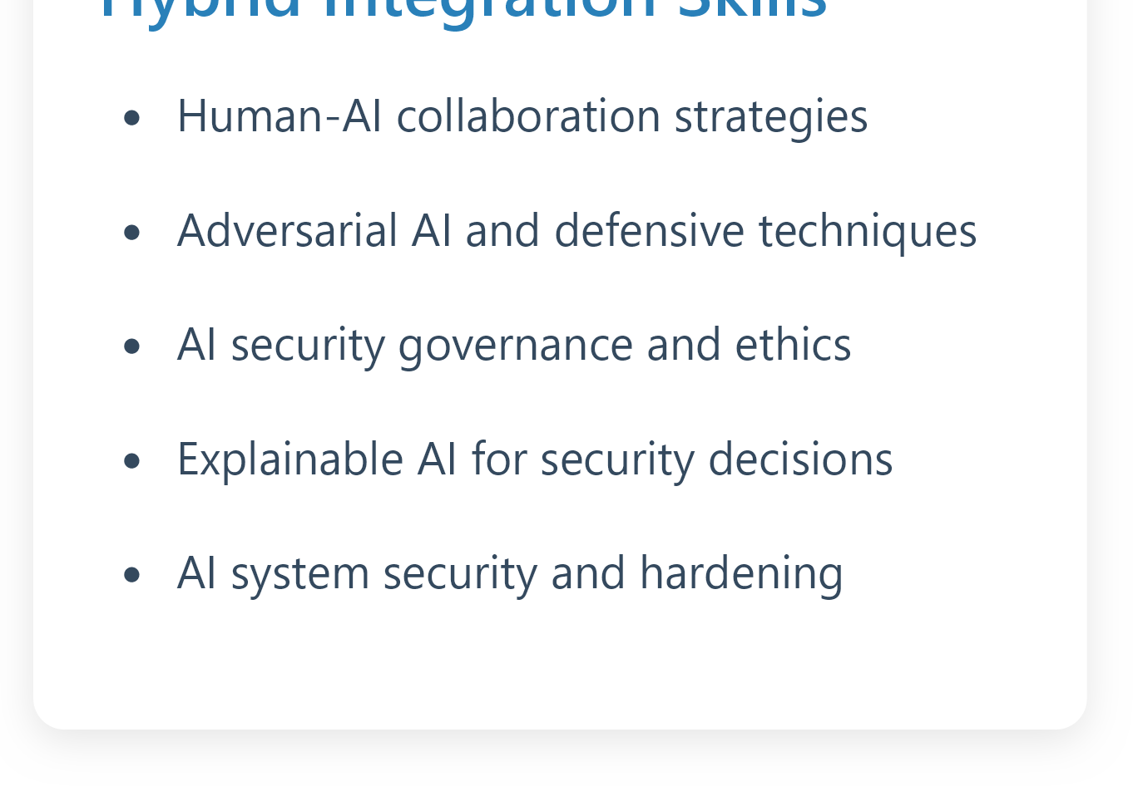
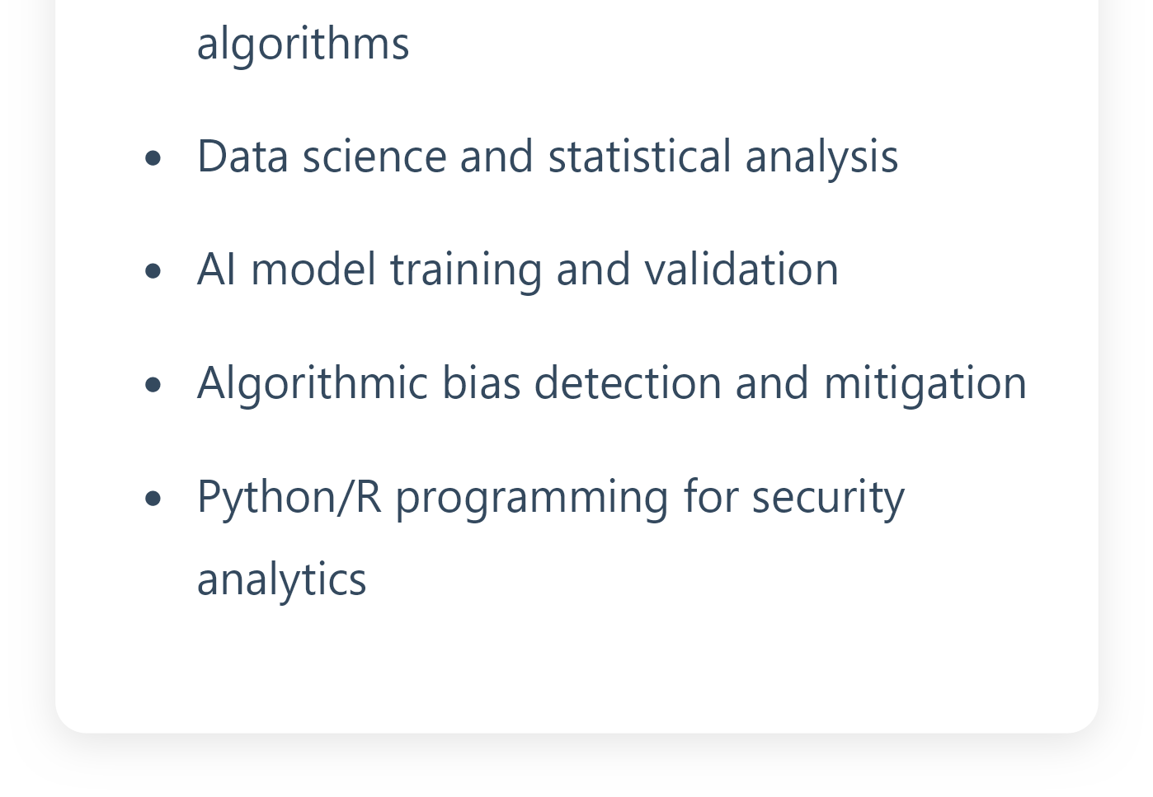
Professional Skills Transformation
7/16

Slide 10
Operational Workflow Evolution
8/16
Tasks Now Automated
Log Analysis: AI processes millions of log entries in real-time
Initial Triage: Automated classification of security incidents
Vulnerability Scanning: Continuous automated network assessment
Compliance Monitoring: Real-time policy violation detection
Threat Intelligence: Automated feed processing and correlation
Basic Response: Automated containment of routine threats
Enhanced Human Roles
Strategic Planning: Long-term security architecture design
Complex Investigation: Multi-stage attack analysis
AI System Management: Tuning and optimizing ML models
Stakeholder Communication: Translating technical risks to business impact
Threat Hunting: Proactive search for advanced threats
Crisis Management: Coordinating response to major incidents

Slide 11
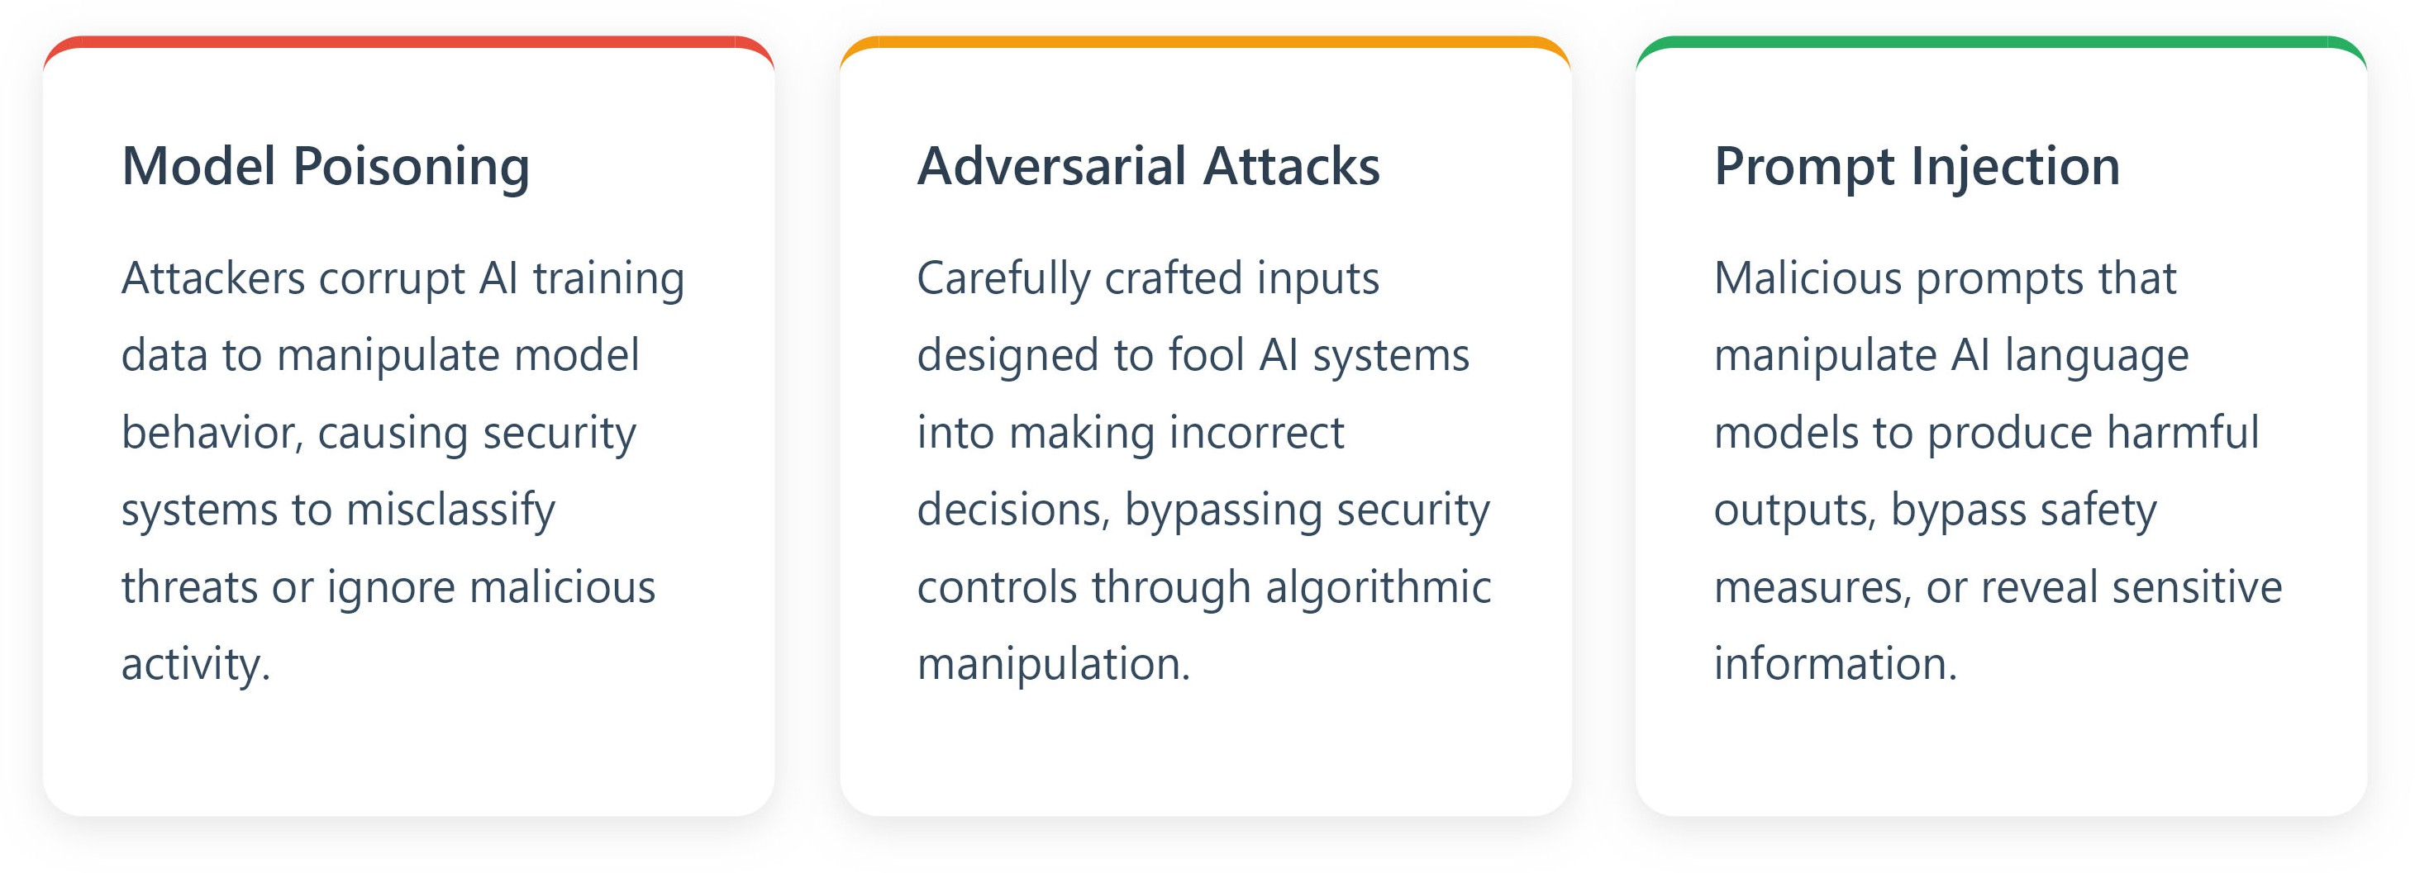
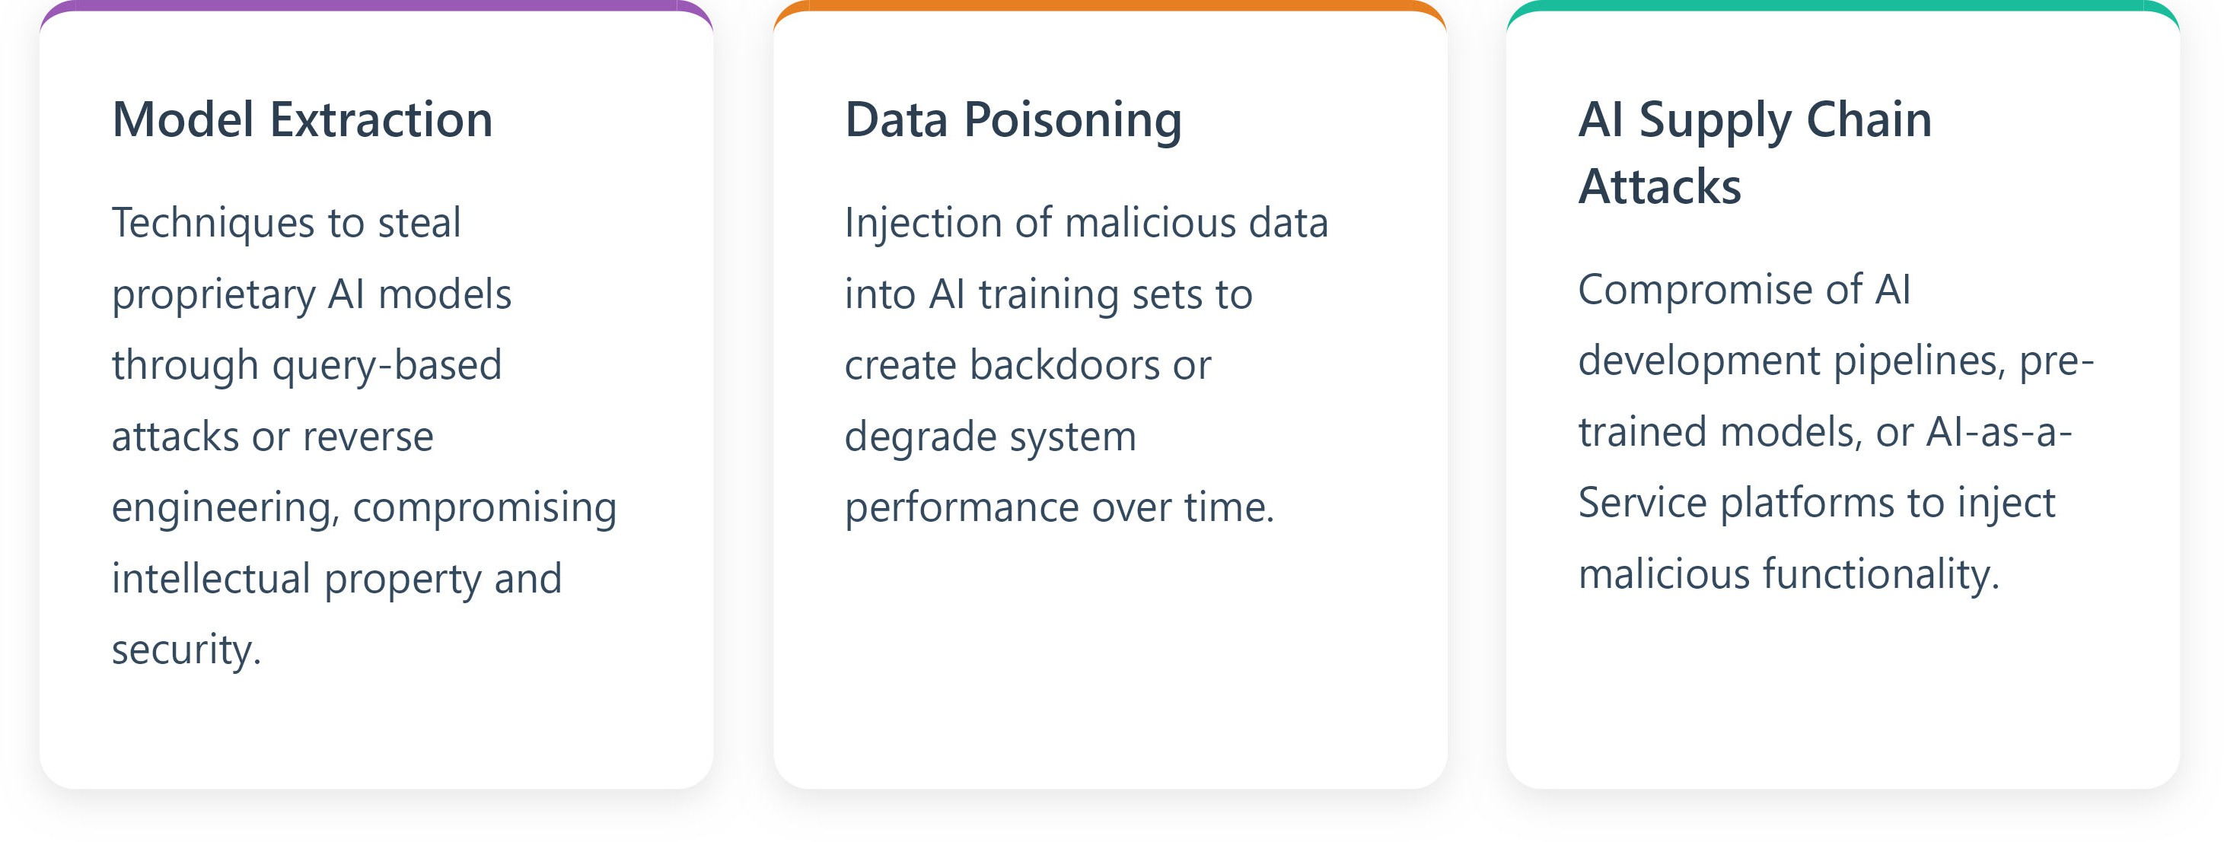
AI-Specific Security Vulnerabilities
9/16

Slide 12
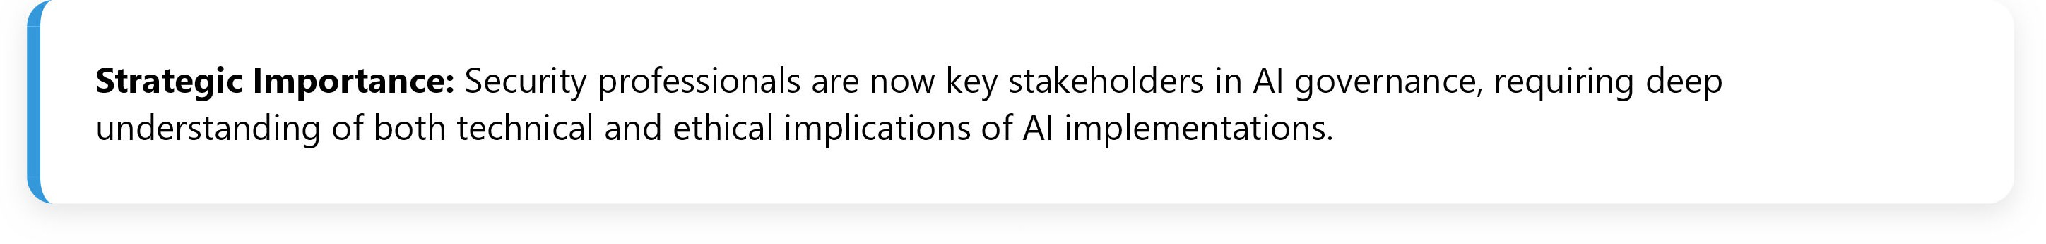
Regulatory and Compliance Evolution
10/16
Emerging AI Governance Requirements
New Compliance Areas
AI Impact Assessments: Mandatory evaluation of AI system risks and societal impact
Algorithmic Transparency: Requirements for explainable AI decisions in critical systems
Bias Testing: Regular audits for discriminatory outcomes in AI applications
Data Governance: Enhanced privacy protection for AI training data
AI Ethics Boards: Governance structures for responsible AI deployment
Professional Implications
Cross-functional Collaboration: Work with legal, ethics, and compliance teams
Documentation Requirements: Comprehensive AI system audit trails
Continuous Monitoring: Ongoing assessment of AI system performance and bias
Incident Response: AI-specific breach notification procedures
Training Requirements: Ongoing education on AI governance and ethics

Slide 13

Career Transformation and Opportunities
11/16
Emerging Specialized Roles
AI Security Architect: Design secure AI systems and infrastructure
ML Security Engineer: Implement and maintain AI-powered security tools
AI Threat Intelligence Analyst: Analyze AI-driven attack patterns
Adversarial AI Specialist: Develop defenses against AI-powered attacks
AI Compliance Officer: Ensure AI systems meet regulatory requirements
AI Ethics and Governance Consultant: Guide responsible AI implementation
Evolved Traditional Roles
Security Analyst → AI-Augmented Threat Hunter
SOC Manager → AI Operations Center Director
CISO → AI-Aware Security Executive
Incident Responder → AI-Assisted Investigation Lead
Compliance Officer → AI Governance Specialist
Security Architect → AI-Integrated Security Designer

Slide 14
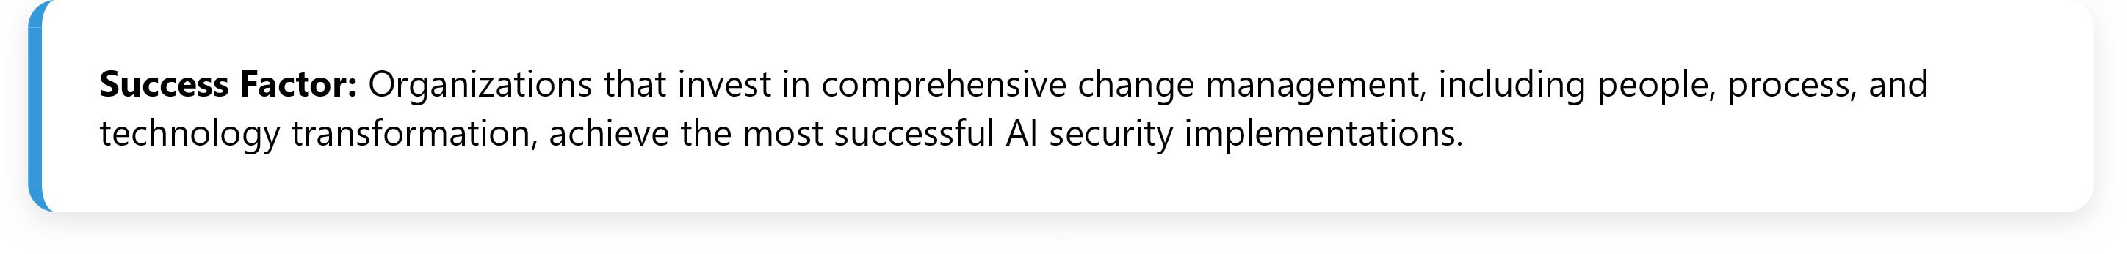
Implementation Challenges and Solutions
12/16
Major Challenges
Skills Gap: Shortage of AI-literate security professionals
Integration Complexity: Difficulty incorporating AI into existing security infrastructure
False Positive Management: Balancing sensitivity with accuracy in AI detection
Explainability: Understanding how AI systems make security decisions
Cost and ROI: Justifying AI investment with measurable returns
Data Quality: Ensuring clean, representative training data
Vendor Selection: Choosing appropriate AI security solutions
Strategic Solutions
Phased Implementation: Gradual AI adoption with pilot programs
Continuous Learning: Ongoing training and certification programs
Human-AI Collaboration: Frameworks for optimal human-machine interaction
Explainable AI: Adoption of interpretable machine learning models
Threat Intelligence Sharing: Collaborative defense through shared AI insights
Cross-functional Teams: Integration of security, data science, and business units
Vendor Partnerships: Strategic relationships with AI security providers

Slide 15
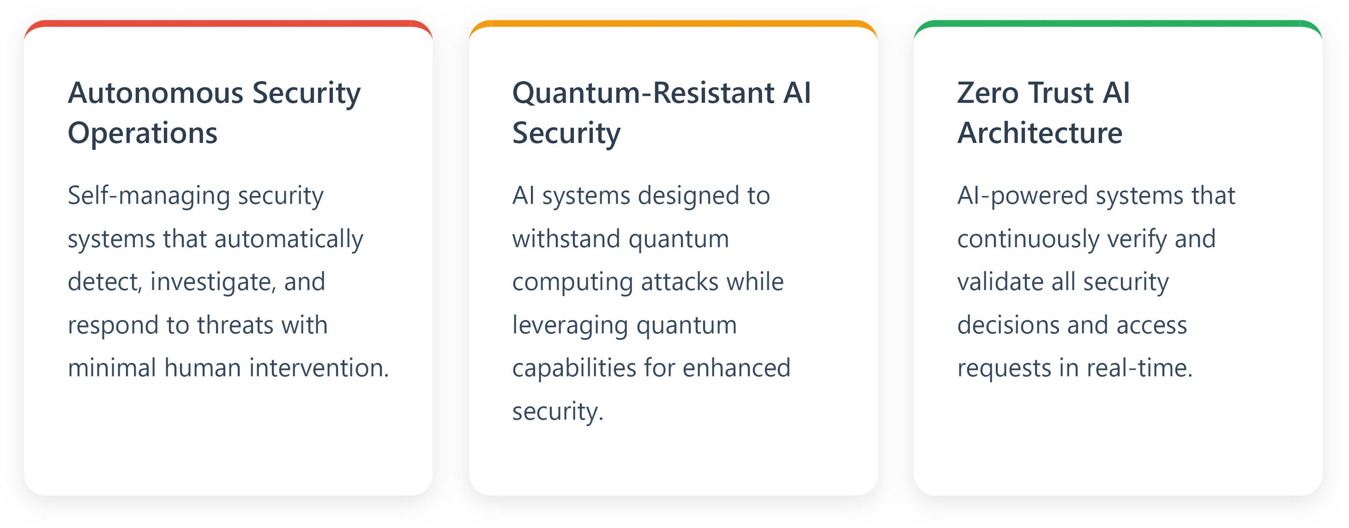
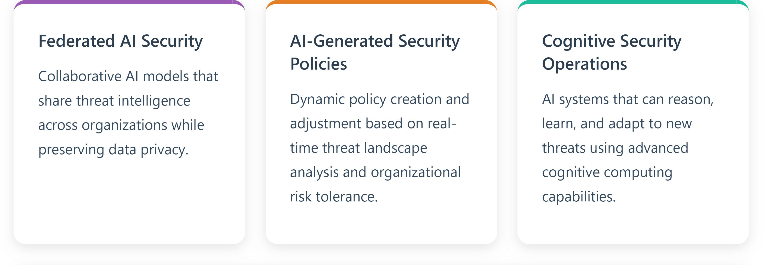
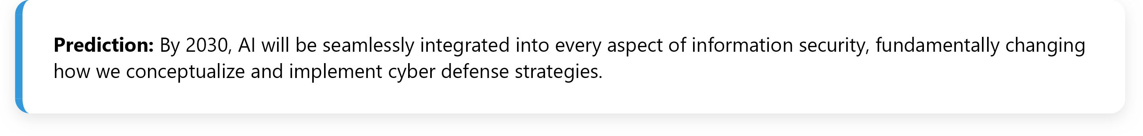
Future of AI in Information Security
Emerging Trends and Technologies
13/16

Slide 16
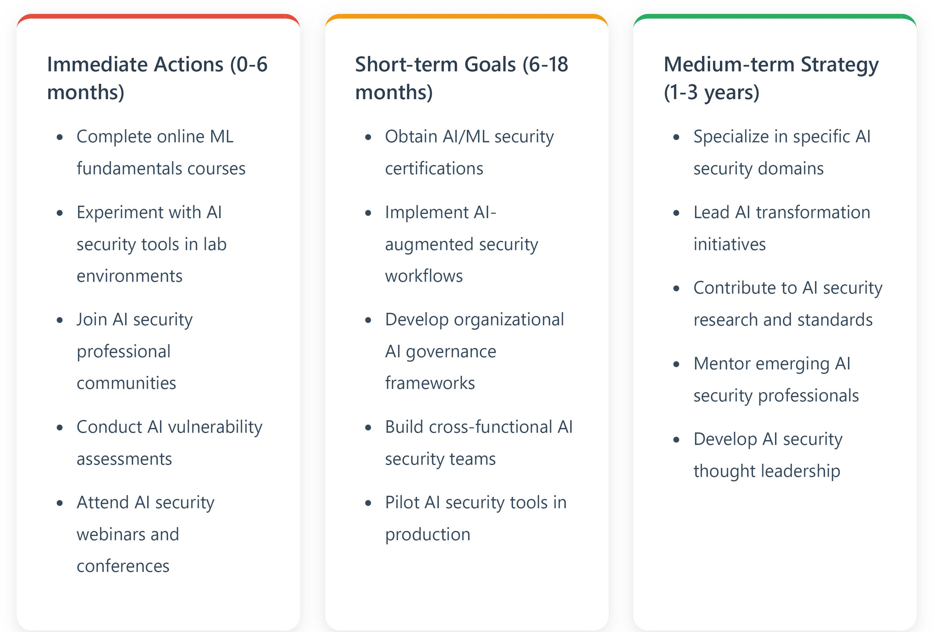
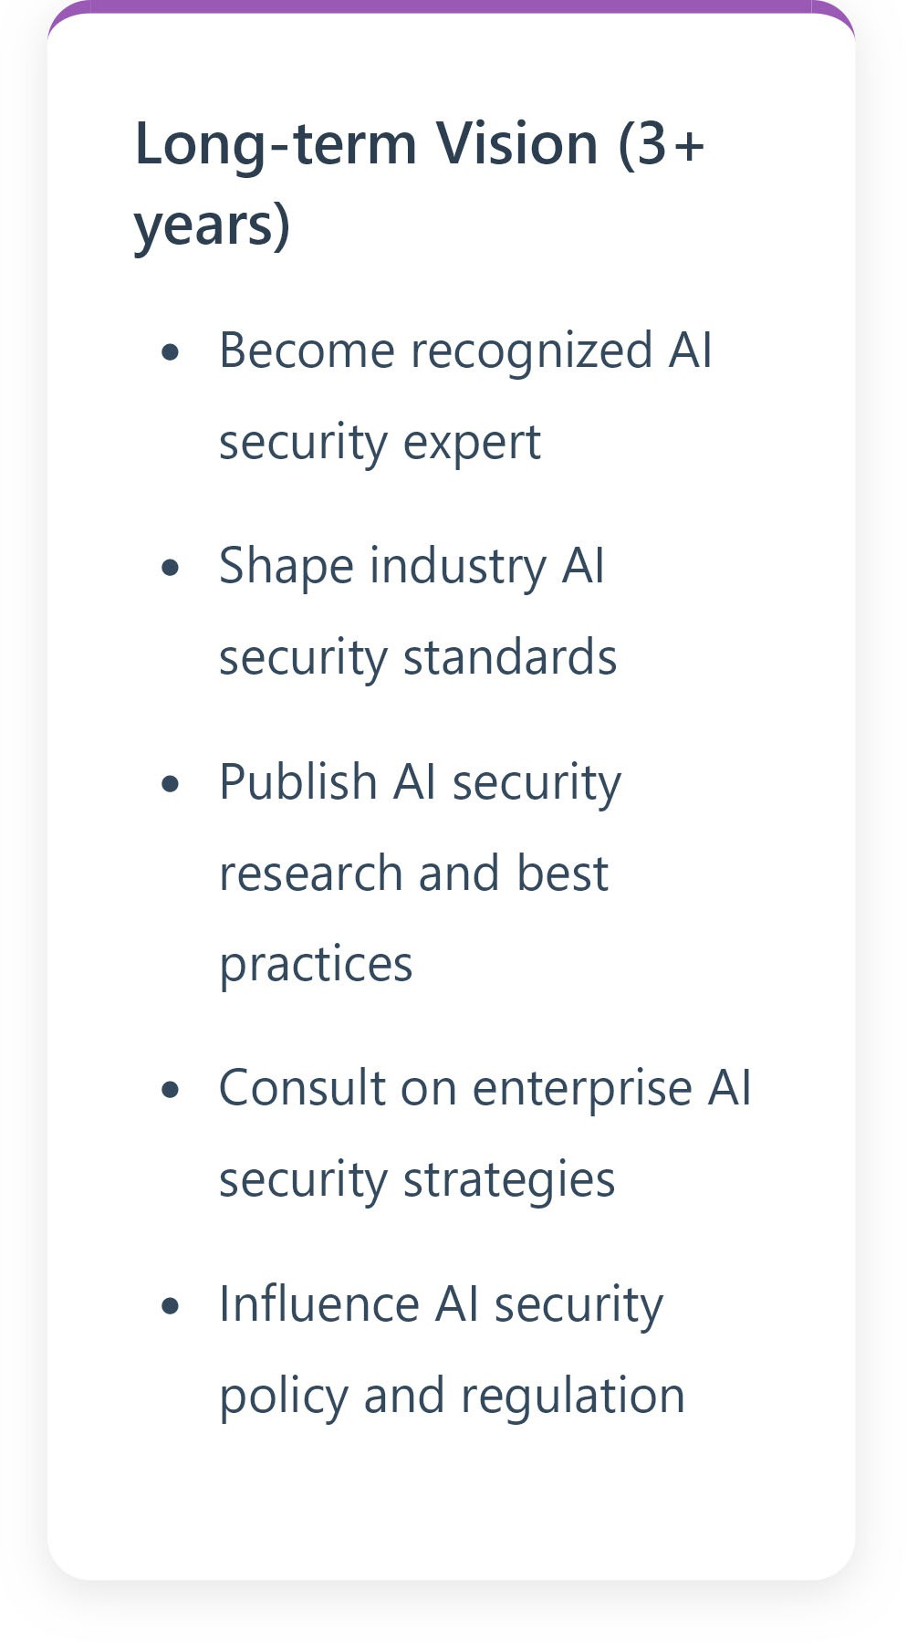
Maintaining Practitioner Relevance
14/16

Slide 17
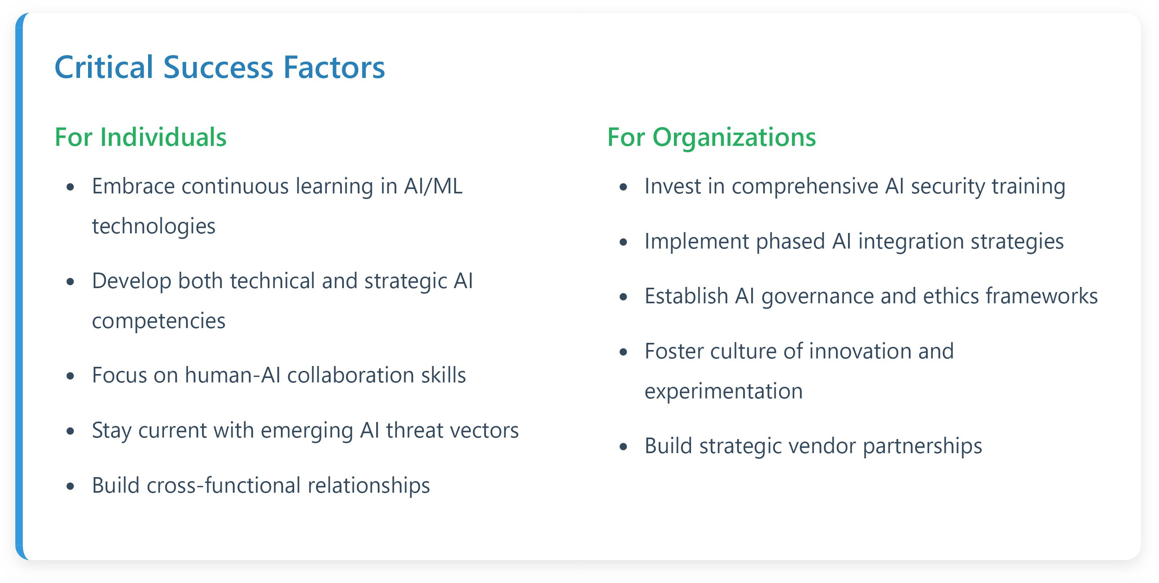
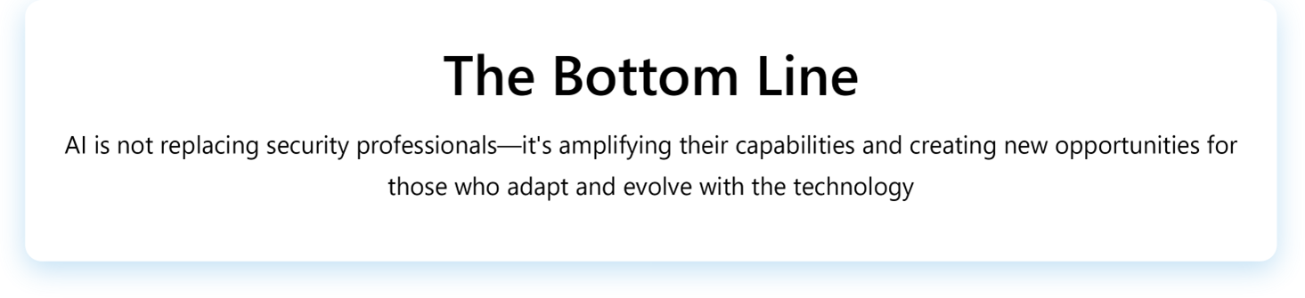
Key Takeaways and Action Items
15/16

Slide 18
Thank you!
Lionel Mew, Ph.D.
Assistant Professor and Chair, Information Systems
School of Professional and Continuing Studies
University of Richmond
lmew@richmond.edu
Office: (804) 289-8944
Cell/text: (804) 384-7913

Slide 19
Cybersecurity Considerations During All-Hazards Incidents
Cybersecurity Considerations During All-Hazards Incidents
Monroe J. Molesky
Cyber Resilience Program Manager
September 3, 2025 – ISOAG Meeting

Slide 20
About VDEM
Mission: To save lives…by coordinating a whole of Commonwealth approach to any complex event or disaster including, but not limited to, any natural, man-made, acts of terrorism, or cyber-related incident or event.
Responsibilities include:
  Develop/Maintain Statewide Emergency Operations Plans
  Coordinate Multiagency/Statewide Responses
  Deliver Training and Exercise Programs
  Support Local 911 Public Safety Answering Points
  Manage Grants as the State Grants Authority

Slide 21
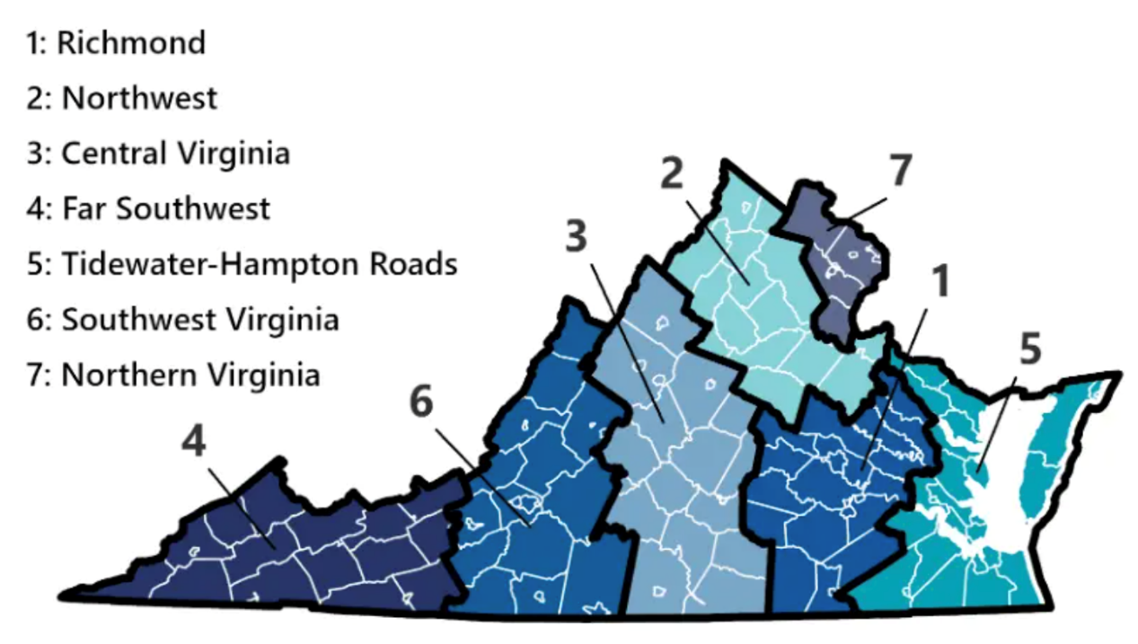
Start Local, End Local
VDEM maintains seven regional offices each with:
  Chief Regional Coordinator
  All-Hazards Planner
  Disaster Response and Recovery Officer
  Recovery and Mitigation Specialist
  Hazardous Materials Officer
~25% of VDEM Staff are Located in Regions

Slide 22
Virginia Emergency Support Team
17 Emergency Support Functions (ESF), sourced from:
  More than 250 members
  State Agencies
  Private Sector
  Non-Governmental Organizations (NGO’s)
Outside the Commonwealth assistance, sourced from:
  Federal Emergency Management Agency (FEMA)
  Emergency Management Assistance Compact (EMAC)
  Department of Defense (DOD)
  Cybersecurity and Infrastructure Security Agency (CISA)
Commonwealth of Virginia Emergency Operations Plan (COVEOP) describes how Virginia will respond and recover from all threats
  Title 44, Code of Virginia and Executive Order (EO) 41
  Includes hazard specific annexes
Primary customers are Virginia Jurisdictions… and critical infrastructure operators.

Slide 23
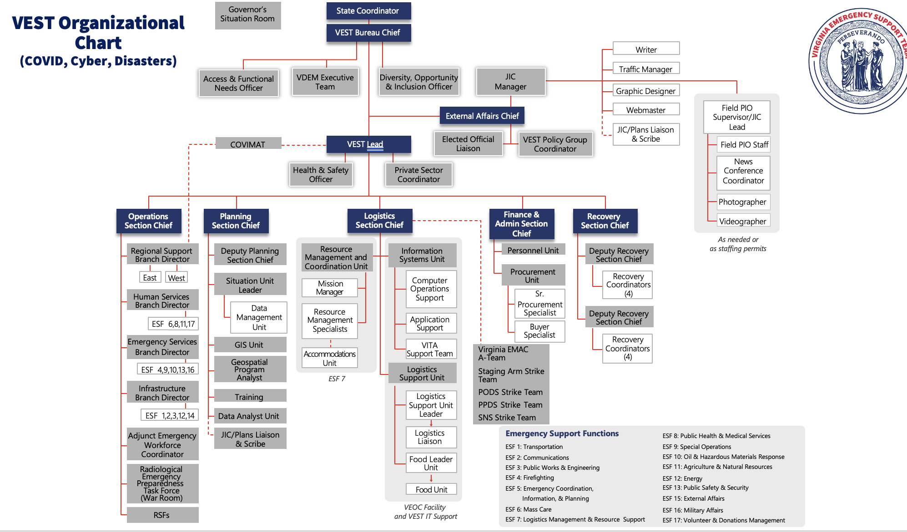
VEST Org Chart

Slide 24
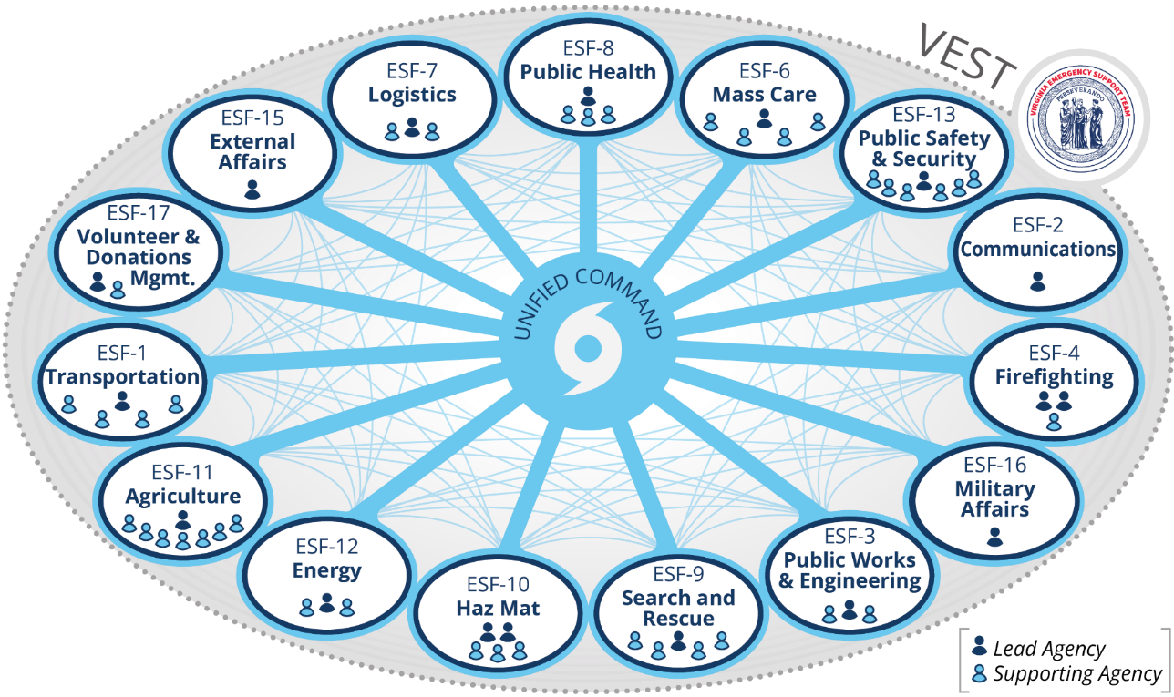
Virginia Emergency Support Team

Slide 25

Cyber and the All-Hazards Landscape in the Commonwealth

Slide 26
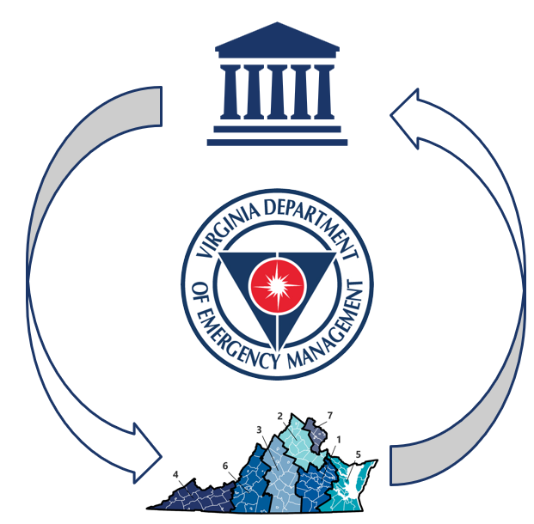
VDEM Cyber Resilience Program
Mission: Bring together public and private sector partners to advance the resiliency of stakeholders across the Commonwealth of Virginia to cybersecurity threats.
Focus Areas:
  Outreach
  Partnerships
  Training, Exercises, & Planning
  Regional Support
  Incident Coordination

Slide 27
Whole-of-Commonwealth Cyber Approach
Shared understanding of community needs and capabilities
Establishment of relationships that facilitate more effective prevention, protection, mitigation, response, and recovery activities
Greater integration of existing resources from local to federal level
Empowerment of innovation and localized solutions

Slide 28
Emergency Management & Cyber
Business Continuity
EM
Ops
IT
SEC
EM
Operational Continuity
Continuity
Consequence Management
Community Resilience

Slide 29
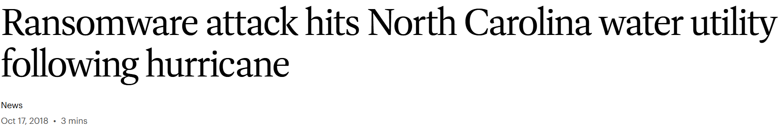

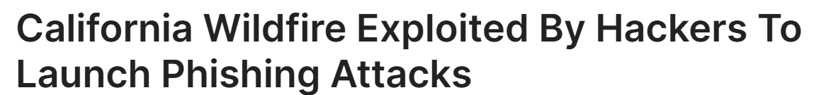
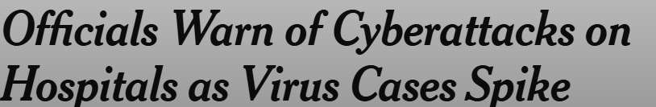
Cyber Threats During All-Hazards Incidents
All-hazards incidents do not always occur singularly, but several incidents and events can occur simultaneously including cyber.
Cyber threat actors increasing seek opportunities to exploit vulnerabilities during occurring non-cyber incidents:

Slide 30
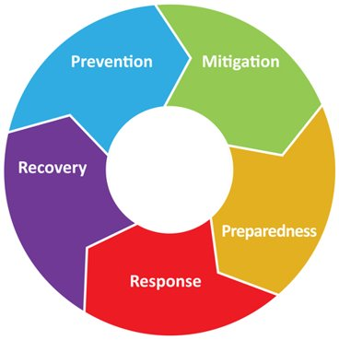
All-Hazards Threats
Examples:
  Chemical Emergencies
  Cybersecurity
  Earthquake and Landslides
  Flooding
  Health Threats
  Hurricanes
  Nuclear Safety
  Terrorism
  Tornados
Emergency Management Cycle

Slide 31
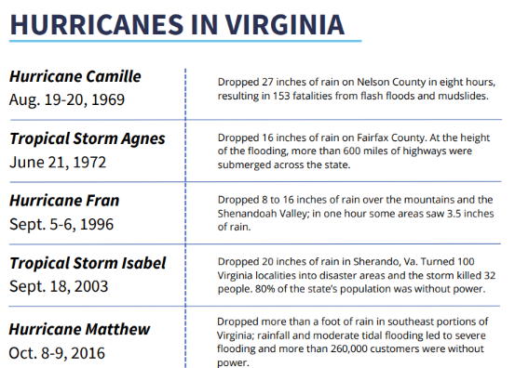
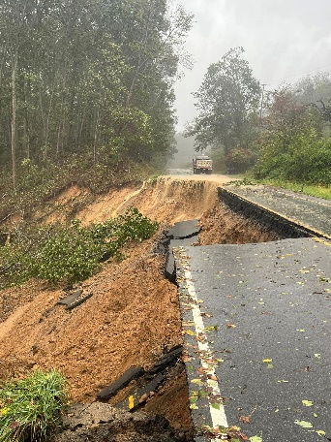
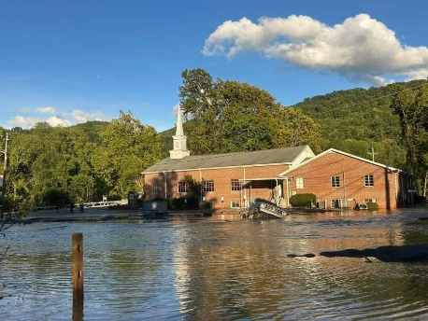
All-Hazard Threats: Hurricane Scenario
Annual Atlantic Hurricane Season: June 1st to November 30th
Hurricane Helene – September 2024
Aftermath of Hurricane Helene in Washington County, VA and Grayson County, VA
(Pictures Taken By VDEM)

Slide 32
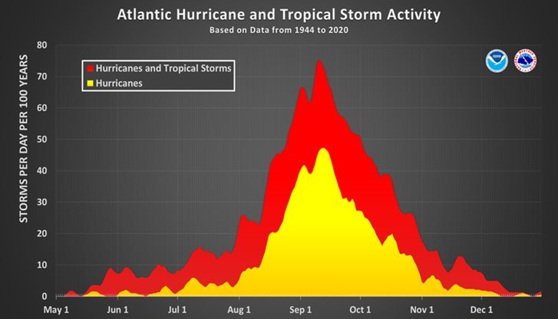

Historical Hurricane Activity
(Courtesy of VDEM Hurricane Program)

Slide 33
What may ISOs consider during an all-hazards incident, such as a hurricane, impacting the Commonwealth?
Question:

Slide 34
Cybersecurity Considerations

Slide 35



Monitor the Landscape
Internal Cyber
  CISA “Shields Up” campaign approach
  Emphasis on monitoring and log review for systems that are public facing, critical for continuity, or essential for public safety in an incident.
External Cyber
  Engage Virginia Fusion Center that integrates both cyber and other intelligence during incidents.
Incident/Emergency Management
  Monitor status of the Virginia Emergency Support Team/Virginia Emergency Operations Center (vaemergency.gov).
  Engage your agency emergency manager (if applicable)

Slide 36



Support Personnel
Educate personnel to identify phishing and scams during incidents.
  Develop and execute all-hazards related security education throughout year.
  Send reminders/information during specific incidents.
Plan for identification and authentication contingencies.
  Communicate alternatives for if a COV issued device/key used for MFA is lost.
  Plan for new or escalated accounts and privileges during surge staffing.
Consider impact of previously scheduled downtime, updates, or other changes.

Slide 37
Physical Security with Cyber
Collaborate with facility personnel to plan for security of IT infrastructure at locations impacted during incidents.
  Physical security with transition to telework during incidents.
Support education on physical-cybersecurity best practices during incidents.
  Reminders on “tailgating” especially with potential new personnel supporting activities.
  Securing physical devices during activities in the field.

Slide 38


Communication
Amplify cyber information during all-hazards incidents to your stakeholders and through existing channels.
Coordinate public incident-related communications with the incident support structure, where appropriate (e.g., VEST Joint Information Center)
Share timely cyber risk and cyber incident information.
  Even during ongoing non-cyber incidents, additional resources to support cyber incident responses are coordinated.

Slide 39
Questions
Monroe J. Molesky, MPH, MBA
Cyber Resilience Program Manager
monroe.molesky@vdem.virginia.gov | (804) 866-7779
cyber@vdem.virginia.gov

Slide 40
CSRM Security Policies and Standards
Information Security Office Advisory Group (ISOAG)
Amy Braden
Director, IT Security Governance & Compliance
September 3, 2025

Slide 41

Authority and scope
Virginia Code § 2.2-2009 creates a scope of cybersecurity governance that is broader than VITA's core executive branch agencies: "executive, legislative, and judicial branches and independent agencies"
But does NOT apply throughout state government, with exclusions for higher ed and authorities
Much less visibility, from both technical and compliance perspectives, outside the executive branch
Primary objectives are to assess security risk, determine appropriate security measures and perform security audits of government electronic information.

Slide 42

Key policies and standards
Key policies and standards
In 2023, Cybersecurity and Risk Management (CSRM) published SEC530 a consolidation of SEC501 and SEC525 and update to the NIST 800-53
8 key policies and standards addressing cybersecurity:
  Information Security Policy (SEC519)
  Information Security Standard (SEC530)
  IT Risk Management Standard (SEC520)
  IT Security Audit Standard (SEC502)
  Security Awareness Training Standard (SEC527)
  IT Standard Use of Non-Commonwealth Computing Devices to Telework (SEC511)
  Removal of Commonwealth Data from Electronic Media Standard (SEC514)
  Data Classification Standard (SEC540)*
Key deliverable guidelines and templates are available on the
VITA website.

Slide 43
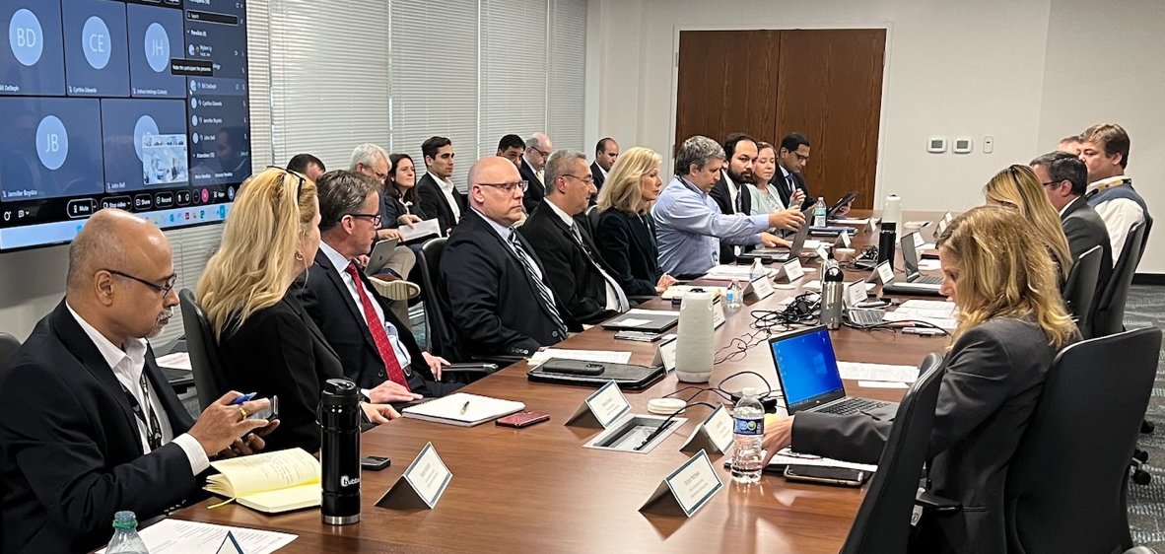
The edit and review process
Document revision process involves collaboration and review with agency ISOs informally and formally.
Documents are posted to ORCA* for a minimum of 30 days for non-administrative changes. If unable comply by the effective date, agencies may submit a security exception outlining that includes a plan to satisfy requirements.
CSRM shares regular updates in monthly forums such as ISOAG and ISO Council
(*VITA's Online Review and Comment Application (ORCA) requires registration but is available to persons outside the executive branch, and even those outside state government entirely.)

Slide 44
How’s it working?

Slide 45


Policy and standards provide Commonwealth flexibility
Policy and standard language is intentionally technology agnostic and non-prescriptive. Agency defined controls are available to accommodate agency needs.
For example, SEC530 has 244 agency defined controls. Applying broad language may be a challenge for some agencies.
Alignment with federal standards (e.g., NIST 800-53), ensures Commonwealth policies and standards meet needs of agencies with additional requirements and meets industry standards. This baseline makes it easier to assess security amid a variety of organizations.
  Federal compliance will streamline Commonwealth compliance too (e.g., FedRAMP).
  But strict federal alignment may appear more restrictive and overburdensome and not necessarily applicable at the state level.

Slide 46
Opportunity for improvements
Resources permitting, CSRM could provide more standards and guidelines to meet specific needs.
Be more prescriptive on how to meet standards.
Provide more training to agencies on how they can leverage current policies and standards to meet their needs.
Better agency and customer engagement as we need robust input.

Slide 47
Thank you

Slide 48
COV Tabletop Exercise 2025
September ISOAG
Name: Zachary Wilton
Date: 9/03/25

Slide 49
Table of Contents/
Agenda
Overview
Expected Outcomes
Event Information

Slide 50
Overview
    The COV Annual Tabletop Exercise is an unclassified, adaptable exercise developed by the MSI/MSS for the Commonwealth of Virginia. The main purpose is to evaluate performance of the multisupplier model, promote dialogue around opportunities for continuous improvement, and identify recommendations for improvement for the COV Cybersecurity Incident Response process.

Slide 51
Expected outcomes
Expected outcome from this event is to conduct a tabletop event where coordination of multiple Suppliers and Service Delivery ensures COV information systems will successfully operate in support of the exercise scenario, and when the managed environment is under attack.
  Demonstrate successful coordination of multiple Supplier Service Delivery
  Ensure COV information systems will successfully operate in support of the exercise scenario
  Enhance awareness, readiness and coordination
  Test capability to determine operational impacts of a cyberattack
  Test participant’s exercise playbooks, incident analysis, incident response plans and procedures, and incident reporting
  Demonstrate compliance with MSI Security Incident Management Process SMM 4.1.5.7 and VITA Playbooks
  Identify Enterprise-wide opportunities for improvement
  Further integration of multi sourcing program between MSI, VITA-CSRM, Service Towers, and the Agencies

Slide 52
Event information
When:
  Exercise: 10/28/2025 (Tuesday)
  After-Action Review: 10/29/2025 (Wednesday)
Who:
  Hosted by: MSI SIRT team (SAIC), MSS SOC (ATOS), and VITA CSRM
  Participants: IT Security Professionals from any/all Agencies and Service Towers part of the VITA Program
Where:
  Virtual only event: A link will be provided at a later date!

Slide 53
Event information
How to join:
  Send an email to MSI-Security-Operations@saic.com stating that your agency/tower would like to participate in this year’s event!
    Please include the names and emails of the specific people that would like to participate from your agency/STS
    RSVP Cut-Off: Oct 17th 2025

Slide 54
Any questions?

Slide 55

Announcements
ISOAG September 2025
Notes:
Example of when to use this slide background for a call out section and text

Slide 56

Acunetix Survey extended
Survey Name: Acunetix 360 Customer Satisfaction Survey
Survey Link: https://forms.office.com/g/K8PbAKrcC5
Available From: August 7, 2025 through September 9, 2025
Why should ISOs do it? It’ll help us spot any gaps and see how the product is performing, so we can make it even better.
vita.virginia.gov
Notes:
This slide background works best with text heavy sections, with no imagery OR when an Icon is used

Slide 57

SPLUNK UPDATE September 2025
WE WANT YOUR LOGS: VITA is working with agencies to ingest their application logs in to the VITA Splunk instance. We ask that all agencies start identifying what logs you would like to have ingested. We are always happy to schedule a call to review your options.
Notes:
Example of when to use this slide background for a call out section and text

Slide 58


Top 5 Vulnerabilities
For the month of September, the Top 5 Key Vulnerabilities are:
Firefox < 141.0
Zoom Workplace < 6.3.10 Vulnerability (ZSB-25030)
Google Chrome < 138.0.7204.168 Multiple Vulnerabilities
Security Updates for Microsoft SQL Server ODBC Driver (April, June, October 2023 and April 2024)
Security Updates for Microsoft SQL Server OLE DB Driver (April June & October 2023, April and July 2024)
*NOTE* Check CSRM Connections for more detailed information
vita.virginia.gov
Notes:
This slide background works best with text heavy sections, with no imagery OR when an Icon is used

Slide 59
Upcoming Events
vita.virginia.gov
Notes:
This slide is used as a transition title slide for a new section

Slide 60

The October 1, 2025 ISOAG Meeting will be In-Person
(and virtual)
Location: Reynolds Community College
Time: 1-4 pm
Please remember that in-person attendance is mandatory for primary, in-scope ISOs to maintain credentials. If one is unable to attend, you must let CSRM know and email the name of the designated person to come in your place by September 17.
In-person
Virtual
Registration:

Slide 61

Governance Office Hours Announcement
Governance Office Hours launch recently – a dedicated space for Agency ISOs and teams to bring their questions, concerns, or ideas directly to the Governance Team.
What to Expect:
Open discussion place
Governance Updates
Q&A and support for your needs
Next Session:
September 10, 2025 | Microsoft Teams
[Click here to join the meeting]
Let’s work together to strengthen governance across the Commonwealth!
Notes:
Example of when to use this slide background for a call out section and text

Slide 62

Service Tower SOC Report Review Sessions
      To register for this meeting, please click on the link below: https://covaconf.webex.com/weblink/register/r356265cb4b5d84cfa98903fb0adb74f2
The upcoming SOC review session is September 18, 2025, and will be held remotely.
Please register at the link below
Notes:
Example of when to use this slide background for a call out section and text

Slide 63

IS Orientation
The next IS Orientation is being held on September 24, 2025
  September 24, from 9am to 4pm, registration closes Sept 17th.
  It will be held in-person at the Boulders location:
  7325 Beaufont Springs Drive, Richmond, VA 23225
  Visit Commonwealth IS Orientation to register!
Notes:
This slide works best with photos and graphs/charts. Image and text can be reversed

Slide 64

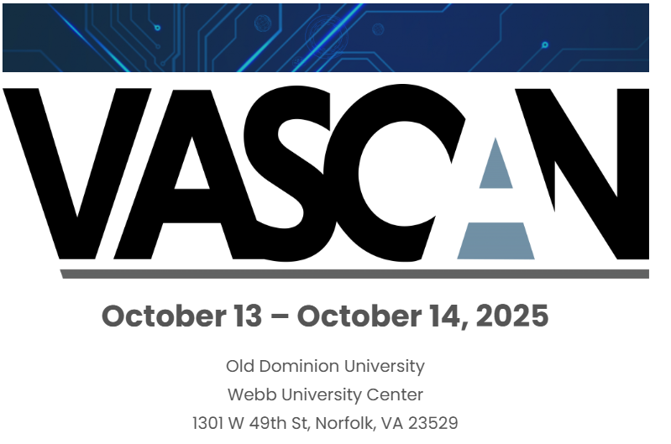
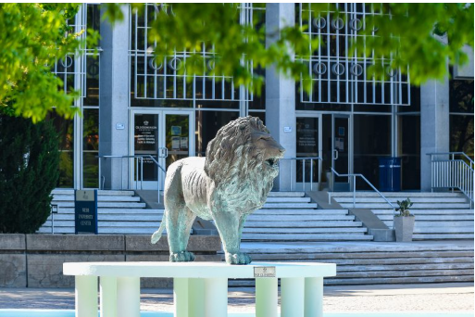
VASCAN
Registration is now open!
Notes:
Example of when to use this slide background for a call out section and text

Slide 65
MEETING ADJOURNED
Notes:
Title slide - Any text that looks black is HEX code 414042. If you have an idea for an image, let me know and I can provide you with one.

Slide 66
Welcome to the Sept. 3, 2025
ISOAG Meeting
Information Security Officer’s
Advisory Group
Notes:
No image title slide - Any text that looks black is HEX code 414042.

Slide 67
WELCOME TO THE Sept. 3, 2025 ​
ISOAG MEETING​
Information Security Officer's
Advisory Group
Notes:
Title slide - Any text that looks black is HEX code 414042. If you have an idea for an image, let me know and I can provide you with one.

